Slide 1
Our Ocean Conference 2018
Notes:
Distinguish delegates, Ladies and Gentlemen,
Good afternoon.
Today I will share the outcomes of the 5th Our Ocean Conference, which was held in Bali on 29th to -30th of October 2018.
The conference was special because it was co chaired by two female ministers: Her Exelency Retno Marsudi, the Minister of Foreign Affairs and Her Exelency Susi Pudjiastuti, the Minister of Marine Affairs and Fisheries.
It reflects Indonesia firm commitments not to only protecting the ocean and making it healthier, but also as a reflection of efforts for women empowerment.

Slide 2
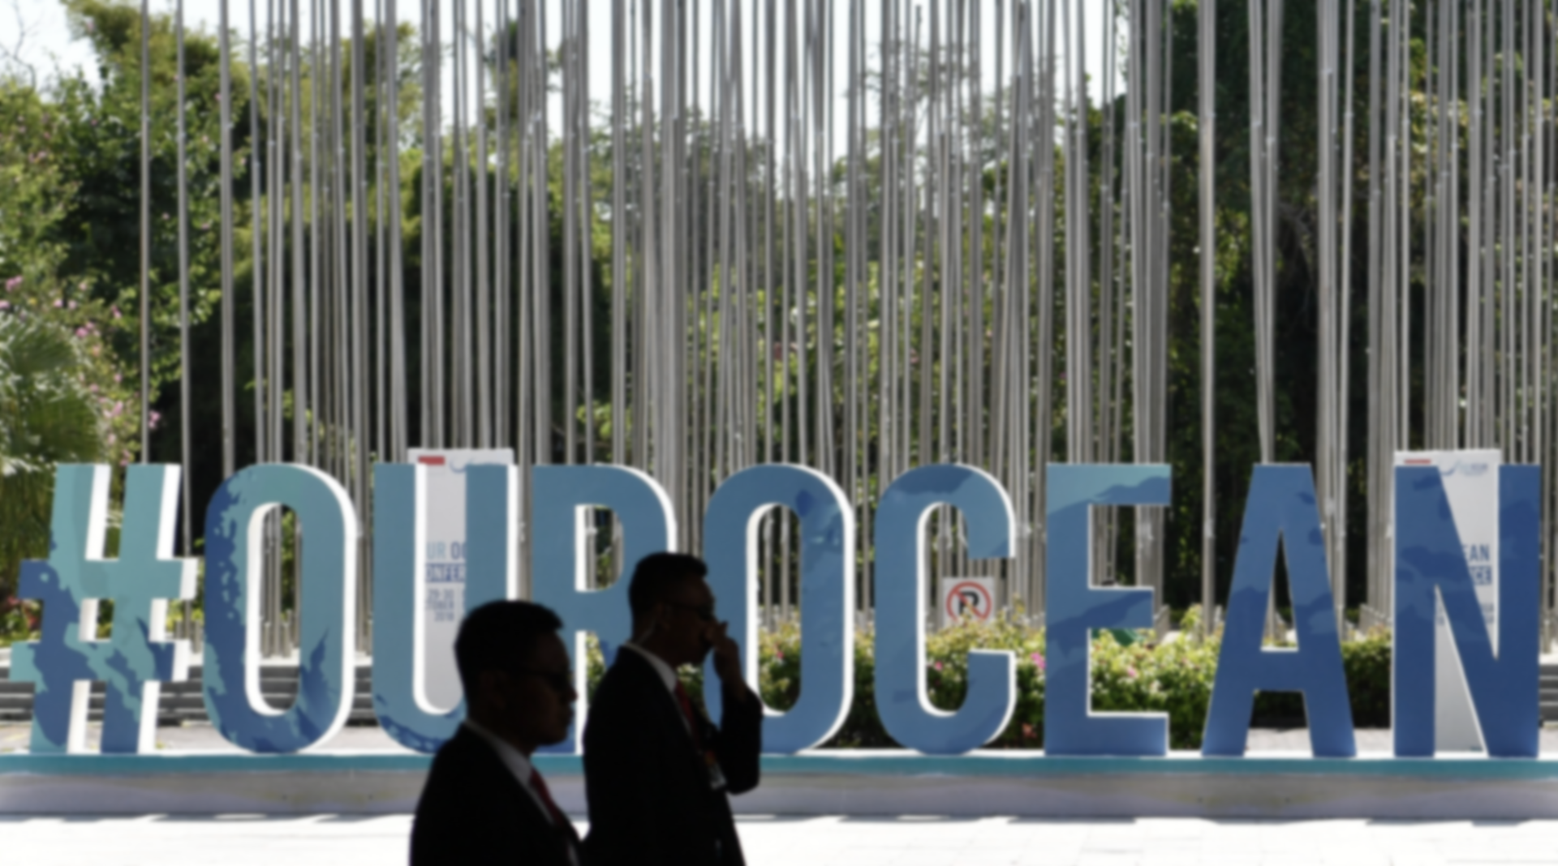
Attended by: 6 Head of States, 29 Ministrial-level officials, foreign delegation of 99 countries, 44 international organization, and other delegations from NGOs, Private Sectors, Academicians, Philanthropist, Youth and Civil Societies
Overall, the Our Ocean Conference attended by 3600 participants.
Our Ocean Conference 2018 “Our Ocean, Our Legacy,” Bali, 29th-30th October 2018
GENERAL OVERVIEW
Notes:
The theme for Our Ocean 2018 is “Our Ocean, Our Legacy”. It reflects the choices to maintain the sustainability of our ocean as a heritage presented for our future generation.
The conference was the first OOC held in Asia and it became the largest conference in terms of the number of delegates and participants.
Officially opened by HE Joko Widodo, The President of the Republic of Indonesia, the conference was attended by 3.600 participants, including 6 Head of States/Governments (Monaco, Palau, Federated States of Micronesia, Nauru, Panama, and Seychelles), 29 Ministers and Ministerial Level, and other foreign delegations from 99 countries.
The conference was also attended by delegations and participants from 44 international organizations, NGOs, private sectors, academicians, philanthropists, youths and civil societies.

Slide 3
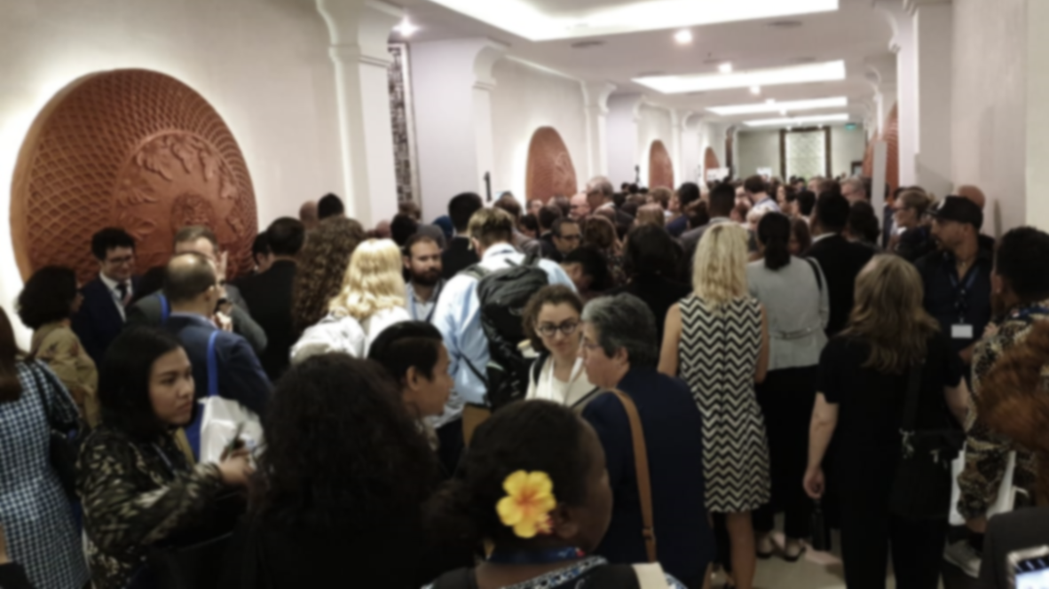
Side Events and Ocean Talks
Side Event:
24 Side Events in OOC 2018
CTI-CFF Side Event:
“Legacy for Strategic Direction for Coral Triangle: Developing Regional Plan of Actions of CTI-CFF by CTI-CFF”
Exhibitions and Ocean Talks:
30 exhibitors (1 for CTI-CFF)
60 Ocean Talks (2 for CTI-CFF):
1. Strategic Direction for Coral Triangle: Update and Way Forward for Regional Plan of Action;
2. Legacy For Coral Triangle – Towards International Recognition for Marine Megabiodiversity Area.
Notes:
Besides the plenary, there were also 24 Side Events, 30 booths of exhibition and 60 ocean talks in OOC 2018.
CTI-CFF actively participated in 1 side event, 1 booth, 1 booth of exhibition and 2 ocean talks.

Slide 4
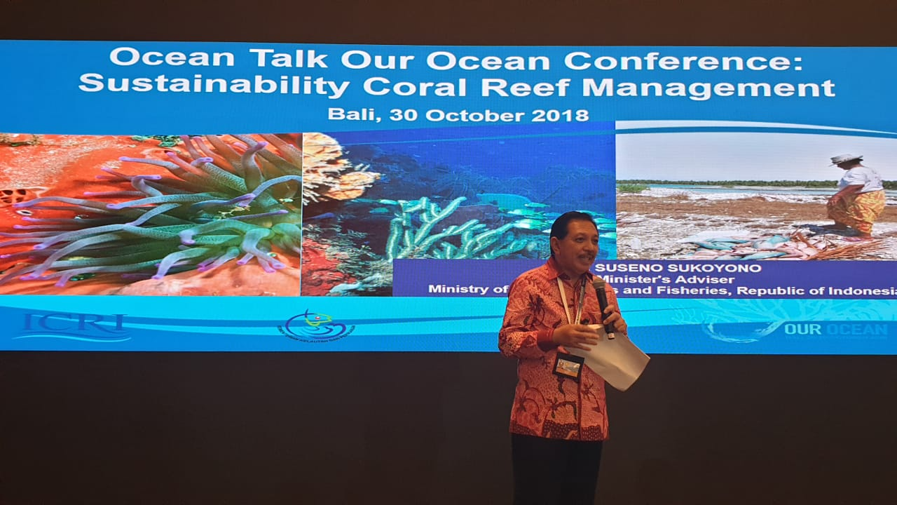
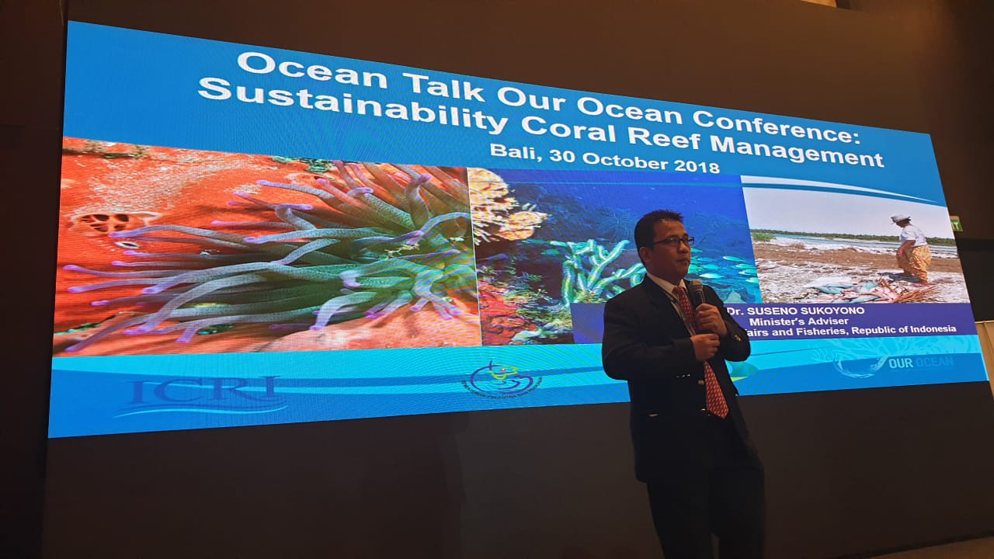
Ocean Talks on Coral Reefs
Presentation by The International Coral Reef Initiative (ICRI)
Sustainable Coral Reef Management Hosted by DG of Marine Spatial Management-MMAF and UNEP
Unlocking the Value of Coastal Ecosystems for Future Generations by Capturing Coral Reef & Related Ecosystem Services (CCRES)
Stay Raja Ampat: Award-Winning Community-Initiative in the Heart of Coral Triangle
Notes:
Other ocean talks related to Coral Reefs are included:
A presentation by International Coral Reef Initiative (ICRI);
Sustainable Coral Reef Management Hosted by DG of Marine Spatial Management-MMAF and UNEP
Unlocking the Value of Coastal Ecosystems for Future Generations Capturing Coral Reef & Related Ecosystem Services hosted by CCRES
Stay Raja Ampat: award-winning community-initiative in the Heart of Coral Triangle

Slide 5
COMMITMENTS
Sustainable Blue Economy
Maritime Security
Climate Related Impacts to The Ocean
Sustainable Fisheries
Notes:
As introduced by the European Union in 2017, the 2018 conference continues to focus on marine protected areas, sustainable fisheries, marine pollution, and climate change-related impacts to the oceans.
It will also maintain the crosscutting themes of sustainable blue economy and maritime security.

Slide 6
Our Ocean Commitments 2014-2017
During 2014 to 2017, the Our Ocean Conference has gathered total of 663 commitments.
Notes:
During 2014 to 2017, the Our Ocean Conference has gathered total of 663 commitments.

Slide 7
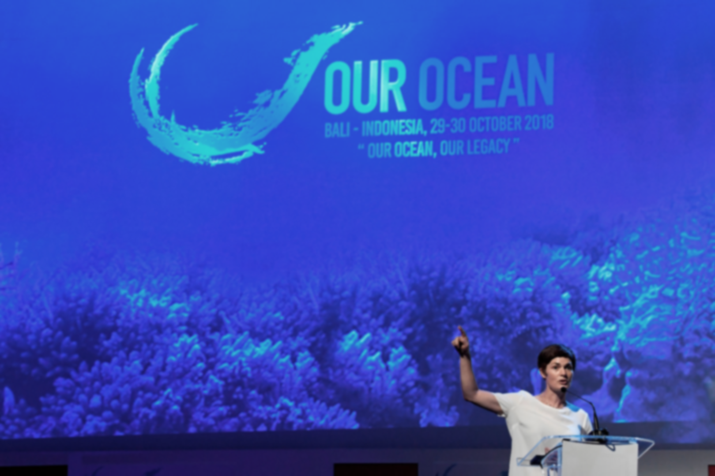
COMMITMENTS OOC 2018
Sustainable Blue Economy
Marine Protected Areas
305 New Commitments
$10.7 Bill USD
14M Km² MPA
Maritime Security
Marine Pollution
Climate Related Impacts to The Ocean
Sustainable Fisheries
Notes:
This year, the Our Ocean Conference has successfully gathered 305 new commitments valued at 10.7 Billion USD, and the establishment of 14 million km square of the new Marine Protected Areas.
In detail, it gathered 62 commitments on Marine Protected Areas, 63 commitments on Marine Pollution, 48 commitments on Sustainable Fisheries, 39 commitments on Climate Related Impacts to the Ocean, 45 commitments on Maritime Security, and 48 commitments on Sustainable Blue Economy.

Slide 8
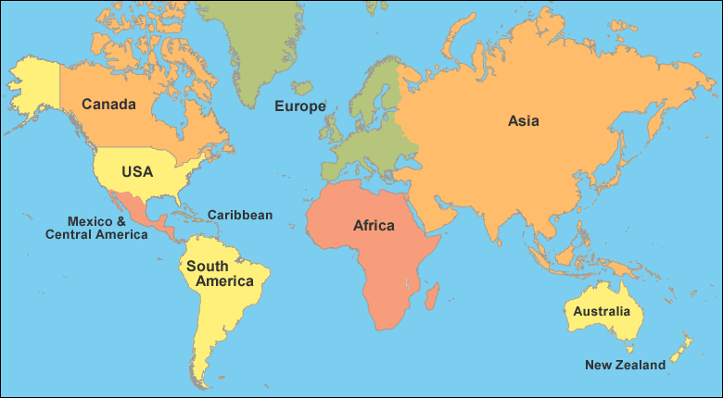
OUR OCEAN CONFERENCE 2018 COMMITMENTS ON CORAL REEF
GEOGRAPHIC SCOPE
COUNTRIES :
CANADA – EUROPE (SWEDEN, GERMANY, FRANCE) – ASIA (JAPAN, INDONESIA) – AUSTRALIA – NEW CALEDONIA
Notes:
Focus on coral reefs, the commitments on coral reefs submitted during the Our Ocean Conference come from Canada; 3 European countries, which are Sweden, Germany, and France; 2 Asian Countries, which are Japan and Indonesia; Australia, and also New Caledonia.

Slide 9
The fifth Our Ocean Conference in Indonesia generates 8 % of commitments on Coral Reef :
Approximately USD 444,7 million monetary commitments for Coral Reef
Approximately 5,3 million km2 of Coral Area (Coral Sea Park, Coral Conservation, etc)
The actions supporting several program partnership : Blue Action Fund, Global Coral Reef Monitoring Network (GCRMN), International Coral Reef Initiative (ICRI)
Entity type : Governments (Canada, Germany, Sweden, France, Japan, Indonesia, Australia, New Caledonia), Intergovernmental Organization (UNESCO World Heritage), NGO (Coral Triangle Center, Coral Vita, Wildlife Conservation Society), Foundation (The Prince Albert II of Monaco Foundation), and Other Organization (ICRI, CTI-CFF)
Notes:
In short, the 5th Our Ocean Conference in Indonesia generates 8 % of commitments on Coral Reef.
The total commitment reach approximately USD 444,7 million in monetary commitments and approximately 5,3 million km2 of Coral Area in form of Coral Sea Park, Coral Conservation, other form of coral reefs protection.
The actions supporting several program partnership, such as Blue Action Fund, Global Coral Reef Monitoring Network (GCRMN), and International Coral Reef Initiative (ICRI)
And if we grouped the commitments based on their entity type, we have 8 Governments (Canada, Germany, Sweden, France, Japan, Indonesia, Australia, New Caledonia), 1 Intergovernmental Organization (UNESCO World Heritage), 3 NGOs (Coral Triangle Center, Coral Vita, Wildlife Conservation Society), 1 Foundation (The Prince Albert II of Monaco Foundation), and Other Organization such as ICRI and CTI-CFF.

Slide 10
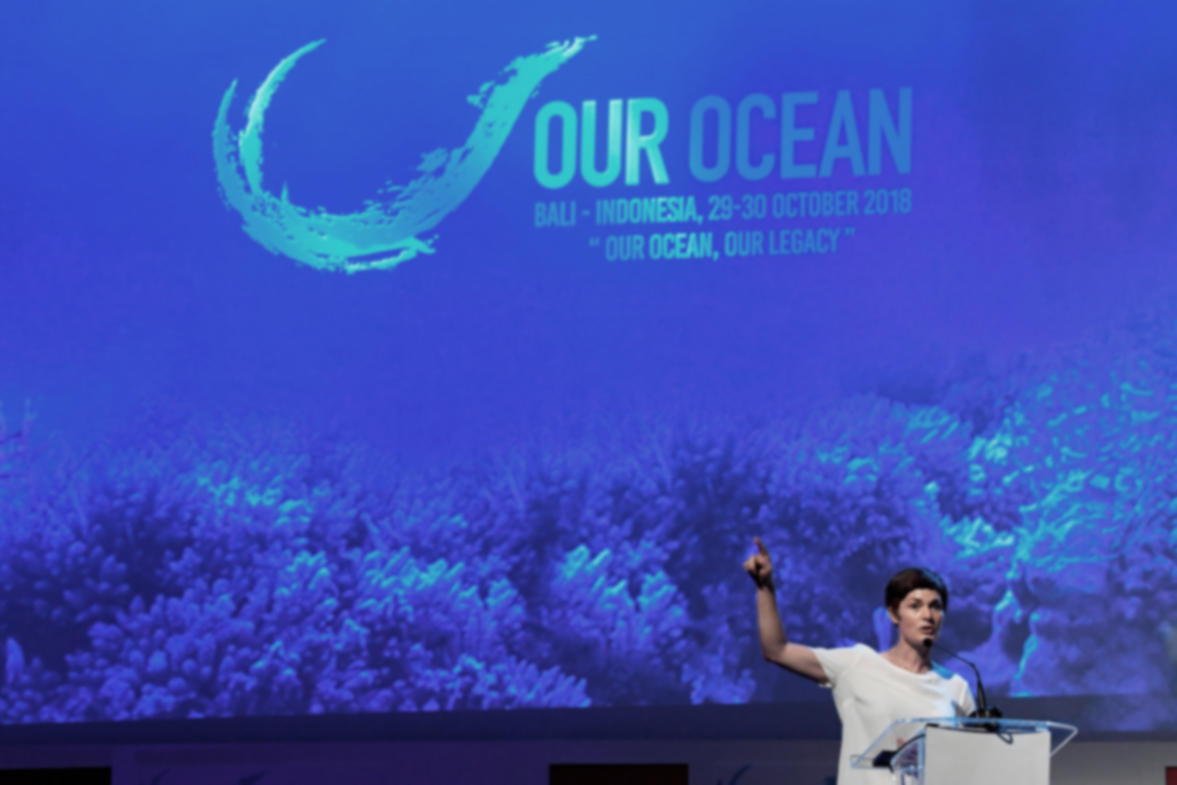
CTI-CFF Commitment in OOC 2018
The Coral Triangle Initiative on Coral reef Fisheries and Food security (CTI CFF) announced its commitment of USD 1.3 million next year for work on preserving, managing and ensuring healthy marine and coastal ecosystem, in the face of climate change. This is a continued commitment since last past three years for more than USD 2 million. This will be accomplished by implementing and strengthening networks of marine protected areas and sustainable fisheries in addressing climate change. CTI-CFF will continue the implementation of the Guide for Vulnerability Assessment and Local Early Action Planning (LEAP Guide) and the CTI-CFF Region-wide Early Action Plan for Climate Change Adaptation (REAP-CCA).
Notes:
CTI-CFF also submitted 1 commitment under Climate Related Impacts to the Ocean, which I believe will be elaborated more by Regional Secretariat.
It announced a commitment of 1.3 million USD for next year to work on preserving, managing and ensuring healthy marine and coastal ecosystem, in the face of climate change. The work is a continued commitment since last past three years for more than USD 2 million and and will be accomplished by implementing and strengthening networks of marine protected areas and sustainable fisheries in addressing climate change. CTI-CFF will continue the implementation of the Guide for Vulnerability Assessment and Local Early Action Planning, the LEAP Guide and also the CTI-CFF Region-wide Early Action Plan for Climate Change Adaptation or REAP-CCA.

Slide 11
THANK YOU

