Slide 1
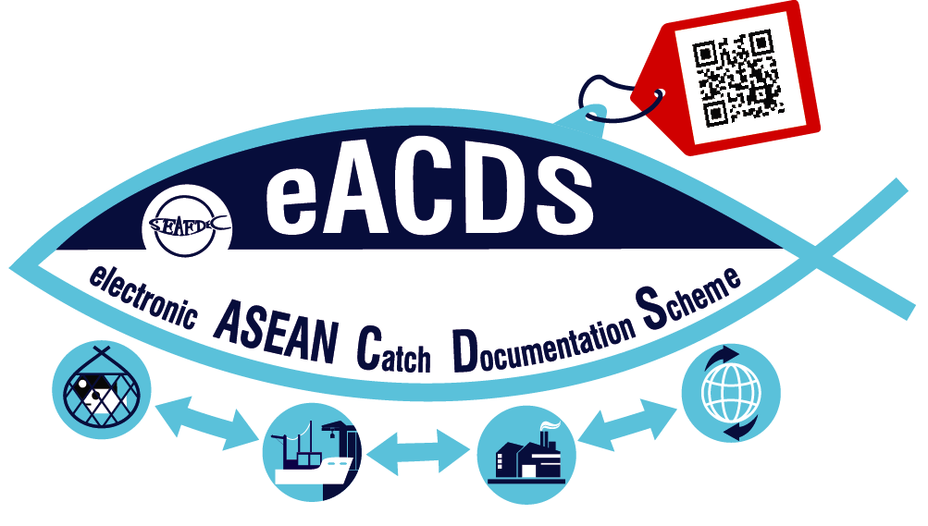
ASEAN CATCH DOCUMENTATION SCHEME (ACDS)
SEAFDEC/ TRAINING DEPARTMENT

Slide 2
INTRODUCTION
2010, introduction of the EC-Regulation in 2010
2014, AMSs expressed their support toward the development of common regional catch documentation scheme/system herein after called “ASEAN Catch Documentation Scheme (ACDS)“
Through the expert meetings and Regional Technical Consultations, the Concept of ACDS was drafted & endorsed by 25ASWGFi in May 2017
To support the implementation of ACDS, the electronic system (eACDS) is needed
Accordingly, JTF in collaboration with SEAFDEC-Sweden and DOF/BN initially developed the eACDS for Pilot Testing;
Notes:
Almost a Decade, after EU introduced the Catch Certification scheme to prevent the entry of IUU fishing products to the EU. Many measures have been introduced to exporting countries, and it was significantly impact to all ASEAN Member States as large exporters to not only EU but all around the world.
By these reasons, ASESAN Member States expressed their support toward the development of Common regional catch documentation scheme, later called ASEAN Catch Documentation Scheme: ACDS. And requested SEAFDEC to develop the said scheme in collaboration with all AMSs and lead ASEAN Country: Singapore.
Through series of expert and regional consultations, the Concept of ACDS was developed and endorsed by 25 ASEAN Sectoral Working Group on Fisheries in May 2017.
To support the implementation under the Concept of ACDS, the electronic system or application software has been developed since then until now;
With the Main financial supports from Government of Japan and Sweden, the electronic system of ASEAN Catch Documentation Scheme or eACDS has been developed with the support from Brunei Darussalam as a Pilot Country.

Slide 3
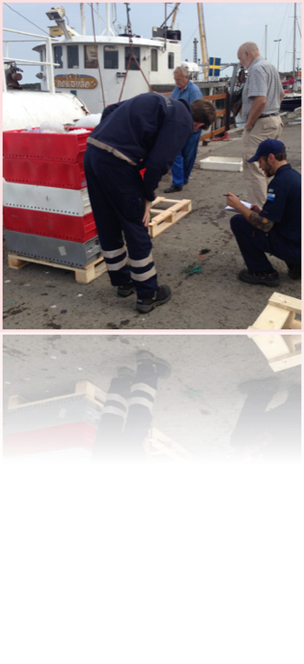
LESSONS LEARNED (before developing eACDS)
eACDS integrated the lessons learned from:
CCAMLR, CDS for Toothfish
SwAM/Sweden, system for EU (testing)
Catch Certification for EU Market:
DOF/THAILAND
MAFF/INDONESIA
FMO/THAILAND: MCPD
Catch Inspection at landing
Sweden
Notes:
In connection to the guidance from the SEAFDEC Councils and recommendations from the Stakeholder consultation, SEAFDEC reviewed and learned from the only existing Catch Documentation Schemes at that time before designing our electronic ASEAN Catch Documentation Schemes.
The lessons learned from various organizations and institutions such as:
The CCAMLR Catch Documentation Schemes for Toothfishs;
the Trails system of Sweden Catch Certification system;
EU catch certificate implementing by Indonesia and Thailand; and
the electronic system of the Marine Catch Purchasing Documents developed by Fish Marketing Organization/ Thailand.

Slide 4
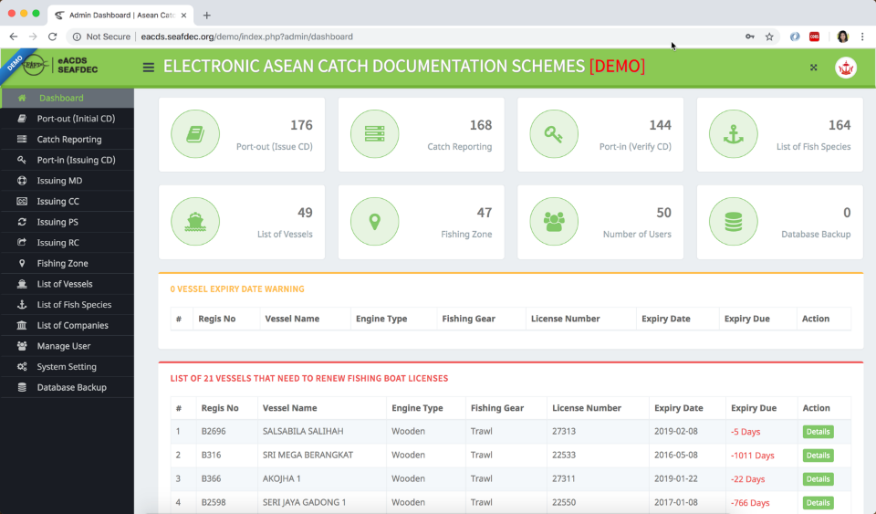
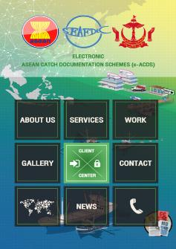
WHAT’S eACDS ?
A Software for Enhancing A Traceability of Fish and Fishery Products from fishing to plate
Implementing eACDS required Good Governance in Fisheries Management: Port control, catch reporting, recording movement of fish in the supply chain, export-import, etc.
Notes:
What is an eACDS? I would like to inform you that the eACDS is a application software that link all information and data and generate the Certifications such as Catch Declaration or CD, Movement Document or MD, and Catch Certification or CC for processor to export their fish and fish products.
In other words, the eACDS is a softwate to support government in enhancing a Traceability of fish and fishery products from origin of fish to plate or to Consumers.
However, the eACDS is designed for implementing that it is needed good governance in fisheries management: such as Port-in/Port-out control, monitoring of catch through the catch reporting at sea and at port, recording of catch movement through purchasing movement document along the supply chains, provide the Catch certificate for exporting, and provide the fish products information to the importer and their consumer via the QR-Code generated by the eACDS system.

Slide 5
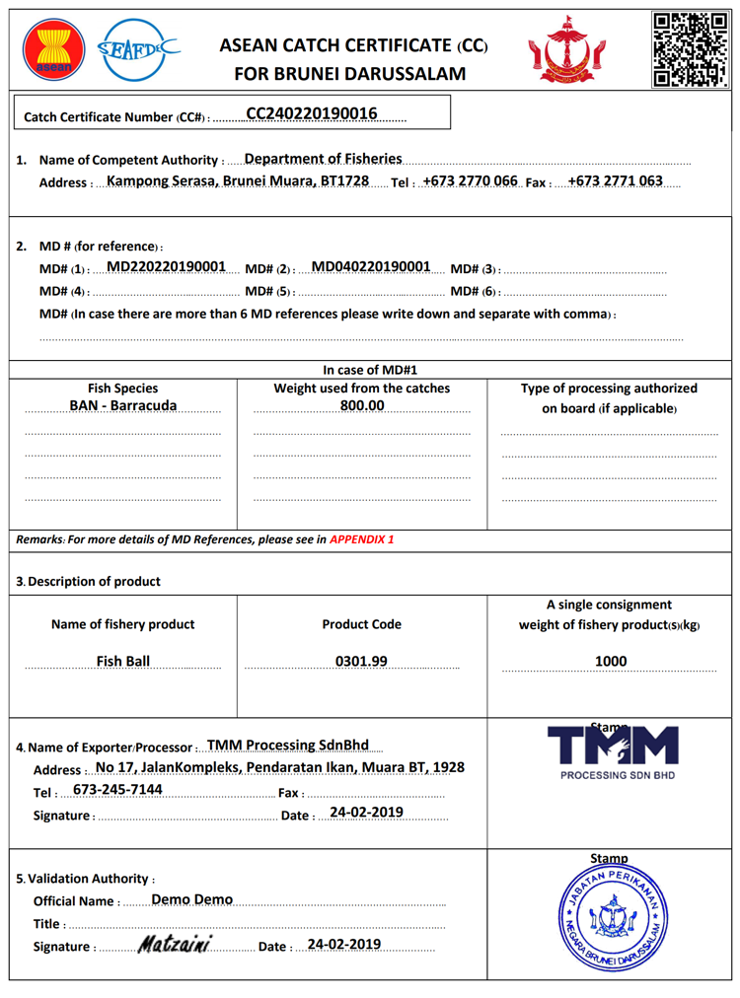
KEY DATA ELEMENTs (KDEs)
Fishing boat/ License
Fish Species Code
Boat Owner/ Fishing Master
Fish Buyers
ACDs
Database
Server
Fishing port
Processors
HS Product Code
Importer/ Exporter
Others
Logistic Info.
Certificate
Notes:
The most important part of the eACDS are the Database Modules that recorded all required Key Data Elements (KDEs) into the system, the database module will create user friendly in implementation of the ACDS especially generating the Certifications based on the processes in the supply chains. The important database module and Key data elements are such as:
Fish species database which is including not only the scientific name, common name and local name, but also include the standard fish code.
Fishing Boat owner or company profile including fishing master
List of Fishing boat and gears license validation;
List of Fishing port
List of fish buyer, brokers
List of processing plants or processors
HS product code
List Exporter/importer
Logistic information, and
Others.

Slide 6
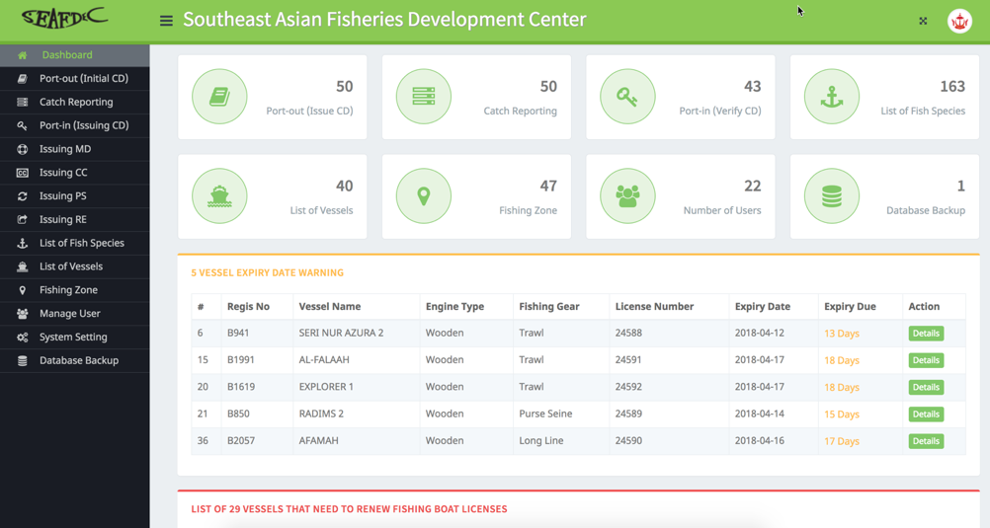
eACDS DATABASE SYSTEM
Web-based Application
Mobile Application
Fisheries Officer
Fishing Master/Fishing Owner
Admin
Director Account
Approve Port-out
Approve Port-in
Issuance Catch Declaration
Issuance Movement Document
Issuance Catch Certificate Document
Catch report at sea
Buyer/Processor
Buyer/Processor
Purchasing Fish
Request Catch Certificate Document
Notes:
eACDS database system is designed on two platforms:
web-based application platform; and
mobile application platform now supports on Android can be downloaded via google Play Store.
For the Web-based application is designed for fishery officers to control all supply chains such as Port-out permission, Port-in permission, issuing the catch declaration, movement document, and catch certificate, etc.
For The Mobile application is for Fishing Master to access for catch reporting at sea and for purchasing fish by fish-buyer and processor at landing port.
In addition, the Web-based application also support the Fish Processor to request for the Catch Certification online.

Slide 7
Web Application
Mobile Application
STEP
FISHERIES OFFICER
1
Port-Out Permission & Issuance of Initial CD
STEP
FISHING MASTER/VESSEL OWNER
2
Catch Report at Sea
STEP
FISHERIES OFFICER
or
3
Port-In Permission, Catch Verification & Issuance of CD
or
STEP
BUYER/PROCESSOR
Purchasing Fish for Local market and/or Processing Plant
4
STEP
FISHERIES OFFICER
5
Issuance of Movement Document (MD)
STEP
IMPORTER/CUSTOM
STEP
BUYER/PROCESSOR
STEP
BUYER/PROCESSOR
9
Trace Fishery Products from QR-Code
6
Request for CC to Catch Certification Unit
8
Export Fishery Product
STEP
FISHERIES OFFICER
7
Issuance of Catch Certificate for Export
Notes:
There are at least 9 Steps for implementation of the eACDS using two applications by different stakeholders and different supply chains. From the slide, you can see the whole process for implementing the eACDS, Regarding this Step 1, 3, 5, 6, 7, and 8 will use Web-based application, while Step 2 and 4 will use Mobile application.
As said there are 9 Steps for implementing the eACDS as follows:
Step 1: Port-out Permission and issuing the initial CD to Fishing master via Web.App.
Step 2: Catch Reporting at Sea by fishing master, In case the fishing vessel do not have signal, the offline reporting system will be functioned;
Step 3: Port-in permission, including catch weight and species verification, and issuing the Catch Declaration to fishing master.. To guarantee that catch from this process are regulated and not come from IUU fishing activities.
Step 4: Purchasing fish by buyer and processor for local market and/or for processing, under this step, the registered buyers have to report to the center/Port by mobile application.
Step 5: Issuance the Movement document (MD) by authorized fishery officer at port, for transferring fish to either local market or Fish processing plant.
Step 6: Fishes that sent to processing plants will be processed, in case for export then the Processor have to request for the Catch Certificate (CC) from Competent authority via Web application;
Step 7: Issuance the Catch Certificate (CC) by the from Competent authority;
Step 8: Export of fish products together with Catch certificate and QR-Code for tracing the origin of fish and products.
Step 9: the consumer trace the fish products using mobile QR-code application.
These all 9 steps of the eACDS system to ensure that fish and fish products can be traced along the supply chains.

Slide 8
THANK YOU

