Slide 1
COUNTRY REPORT OF INDONESIA
Dr Suseno Sukoyono
Head of Indonesia Delegation
Ministry of Marine Affairs and Fisheries, Republic of Indonesia

Slide 2
TOPIC OUTLINE
Country TWG Focal Points
Progress Towards NPOA
Lesson Learned
Challenges
Next Steps

Slide 3
STRENGTHENING NCC INDONESIA
Presidential Decree of the Republic of Indonesia No. 85/2015 as of 23 July 2015.
The Coordinating Minister for Maritime Affairs Decree No. SKEP/9/Menko/Maritim/III/2016 as of 31 March 2016
Director General Marine Spatial Management Decree No. 27/KEP-DJPRL/2016 as of 2 August 2016.

Slide 4
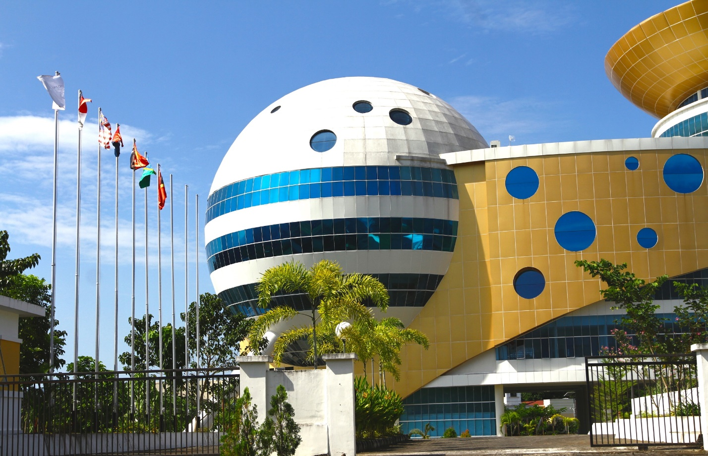
INDONESIA SUPPORT TO REGIONAL SECRETARIAT
Annual financial contribution with amount of USD 366,082.00 to CTI-CFF Regional Secretariat as of 16 March 2016.
Presidential Decree No. 46/2016 as of 18 May 2016.
Permanent office of Regional Secretariat in Manado as of 11 July 2016

Slide 5
Country TWG Focal Points
TWG | Focal Point
Seascapes | Mr. Subandono Diposaptono, Director of Marine Spatial Planning, MMAF
EAFM | Mr. Toni Ruchimat, Director of Fish Resources Management, MMAF
MPA | Mr. Andi Rusandi, Director of Marine Biodiversity Conservation, MMAF
CCA | Ms. Sri Tantri Arundhati, Director of Climate Change Adaptation, Ministry of Environment and Forestry
Threatened Species | Mr. Andi Rusandi, Director of Marine Biodiversity Conservation, MMAF
CROSS – CUTTING
Capacity Building | Mr. Maman Hermawan, Secretary of Marine and Fisheries Human Resources Development Agency, MMAF
Food Security | Ms. Sri Yanti, Acting Director for Marine and Fisheries
Data and Information | Mr. Dirhamsyah, Director of Oceanography Research Center, Indonesia Institute of Science

Slide 6
RPOA
NPOA
SEASCAPE
EAFM
MPA
CCA
TS
CROSS CUTTING
CAPACITY BUILDING
DATA & INFORMATION
FOOD SECURITY

Slide 7
UNITED NATION ENVIRONMENT ASSEMBLY-2 (UNEA-2)
May 23rd to 27th, 2016 in Nairobi, Kenya,
The resolution Sustainable Coral Reefs Management No. EA.2/L.13
Side event, May 23rd : Sustainable Coral Reefs Management.
Consultation Meeting
28-29 June 2016 in Manado,
“In Global Environment Outlook (GEO) 6, UNEP will include coral reefs aspects, particularly information on global coral bleaching, climate change projection to coral reefs and mesophotic reefs.”
Marine debris and Micro plastics
More than 150 million tons of plastic debris end up floating in world oceans
(Coordinating Minister of Maritime Affairs, Ministry of Environment and Forestry and Ministry of Marine Affairs and Fisheries)

Slide 8
CELEBRATING CORAL TRIANGLE DAY 2016
“Save Coral Reefs, Stop Plastic Pollution”
Beach Clean Up, mangrove planting, coral reefs rehabilitation, promote marine debris management, scientific focus discussion, ceremonial, on June 6th – 11th 2016 lead by NCC CTI-CFF Indonesia Turning Trash into Art to Inspire Ocean Conservation, on June 11th, 2016 lead by CTC
Sanur’s Coral Reefs get a Boost from Adopt-A-Coral Activity and Underwater Clean Up Dive, on June 15th, 2016 by CTC
Beach Clean Up, seminar on mangrove, mangrove planting, in June 2016, lead by WWF

Slide 9
ACHIEVEMENT (INDONESIA CONTRIBUTION)
Progress Towards NPOA
National Marine Spatial Planning
will be finalized and enacted by Dec 2016
Provincial Technical Guideline :
Coastal And Small Island Zoning Plan have been enacted through Ministerial Decree No. 23/2016 (Aug 2016)
Provincial Working Group:
34 Provincial Coastal And Small Island Zoning Plan have been established by Governor
Goal 1: Priority Seascapes Designated and Effectively Managed
Goal 2: Ecosystem approach to management of fisheries and other marine resources is fully applied
CHALLENGES
Goal 3: Marine Protected Areas (MPAs) established and effectively managed
Lack of data, manpower and expertise
New regulation on local government authority
Goal 4: Climate Change Adaptation Measures Achieved
LESSON LEARNED
Data & information and public engagement play important role on the development of seascape management plan
Goal 5:Threatened Species Status Improving
NEXT STEP
Socialize National Marine Spatial Planning
Finalize and Enact 34 Provincial Coastal And Small Island Zoning Plan

Slide 10
ACHIEVEMENT (INDONESIA CONTRIBUTION)
Progress Towards NPOA
Ministerial MAF Decree No. 107/KEPMEN-KP/2015
Fisheries Management Plan for Tuna, Skipjack Tuna, and Mackarel Tuna
Collaborative Management National and Local
Reef fisheries management in NTB Province by involving national and local stakeholder (2015)
Goal 1: Priority Seascapes Designated and Effectively Managed
Goal 2: Ecosystem approach to management of fisheries and other marine resources is fully applied
Goal 3: Marine Protected Areas (MPAs) established and effectively managed
CHALLENGES
New regulation on local government authority
Goal 4: Climate Change Adaptation Measures Achieved
LESSON LEARNED
Collaborative management create more comprehensive management and well structured
Goal 5:Threatened Species Status Improving
NEXT STEP
Establishment management authority in all National FMAs

Slide 11
ACHIEVEMENT (INDONESIA CONTRIBUTION)
Progress Towards NPOA
Ministerial MAF Decree No. 13/2014
MPA Management through MPAs network
Ministerial MAF Decree No. 21/2015
Public involvement in MPA management
Management Effectiveness Evaluation Tools (E-KKP3K)
Tool to evaluate MPA management is available
Technical Guidelines
MPA planning and management
Goal 1: Priority Seascapes Designated and Effectively Managed
Goal 2: Ecosystem approach to management of fisheries and other marine resources is fully applied
CHALLENGES
Goal 3: Marine Protected Areas (MPAs) established and effectively managed
Enforcement on zoning compliance and destructive fishing
Goal 4: Climate Change Adaptation Measures Achieved
LESSON LEARNED
Community participation has vital roles in MPA management
Goal 5:Threatened Species Status Improving
NEXT STEP
Increase public private people partnership in MPA management

Slide 12
ACHIEVEMENT (INDONESIA CONTRIBUTION)
Progress Towards NPOA
Act No. 32/2009
Obligations related to climate change adaptation
National Action Plan of Climate Change Adaptation (RAN API)
Early Warning System
Established in Malang, Morotai and Mentawai
Indonesia Coastal Education (Sekolah Pantai Indonesia)
Curiculum material on CCA
Coastal Resilient Village (PDPT)
66 villages in 22 regencies/municipalities
Goal 1: Priority Seascapes Designated and Effectively Managed
Goal 2: Ecosystem approach to management of fisheries and other marine resources is fully applied
Goal 3: Marine Protected Areas (MPAs) established and effectively managed
CHALLENGES
Goal 4: Climate Change Adaptation Measures Achieved
Sharing data and information among stakeholder
LESSON LEARNED
Goal 5:Threatened Species Status Improving
Early education on CCA is very important
NEXT STEP
Establish National Center of Excellence

Slide 13
ACHIEVEMENT (INDONESIA CONTRIBUTION)
Progress Towards NPOA
Ministerial Decree on Threatened Species Protection
Hammerhead Sharks, Whale Sharks, and Manta Ray
National Plan of Action 2016-2020
To protect Sharks, Sea Turtles, and Dugong
Data collection and consolidation
Sharks, Sea Turtles and Dugong
Technical Guideline
Handling stranded marine mammals, identification of sharks and sea turtles, and handling by-catch of sharks and sea turtles
Goal 1: Priority Seascapes Designated and Effectively Managed
Goal 2: Ecosystem approach to management of fisheries and other marine resources is fully applied
Goal 3: Marine Protected Areas (MPAs) established and effectively managed
CHALLENGES
Coordination in updating database in national level
Goal 4: Climate Change Adaptation Measures Achieved
LESSON LEARNED
Scientific data plays important role in generating policy
Goal 5:Threatened Species Status Improving
NEXT STEP
Sharing information on connectivity of species migration to support management network in CT6 countries

Slide 14
Thank you

Slide 15
ANNEX

Slide 16
Partners and Status of Partnership
Logo Partners
Partner | Status | Projects and Programs | Goal
CTC | MoU & IA | SEA Project | 2; 3; 5;
 |  | Seanet | 2 (WPP 718)
WWF | MoU | SEA Project | 2; 3; 5;
 |  | Dugong Seascape Conservation Project | 5
 |  | By-catch Mitigation Program | 5
CI | MoU | Papuan Bird’s Head Seascape Program: Establishment and management of Marine Protected Area (MPA) network in Raja Ampat and Kaimana areas | 3
Notes:
Goal: 1. Seascape; 2. EAFM; 3. MPA; 4. CCA, 5. EAFM

Slide 17
Partners and Status of Partnership
Partner | Status | Projects and Programs | Goal
 |  | MPA Network Program in Bali and Development of MPA Model in Karangasem with “downstream-upstream” concept | 3
 |  | Improve ecosystem-based integrated management in Anambas-Natuna Seascape (Phase I) | 1
 |  | Manta Ray Conservation Program | 5
 |  | Human resource development program for MPA management | 3
 |  | Blue carbon initiative | 3;4
GIZ | MoU | Sulu Sulawesi Seascape | 1;2;3

