Slide 1
SOM14
14th Senior Officials’ Meeting
11-12 December 2018
Manila, Philippines
SESSION 10: COUNTRY REPORT
Papua New Guinea
Conservation and Environment Protection Authority

Slide 2
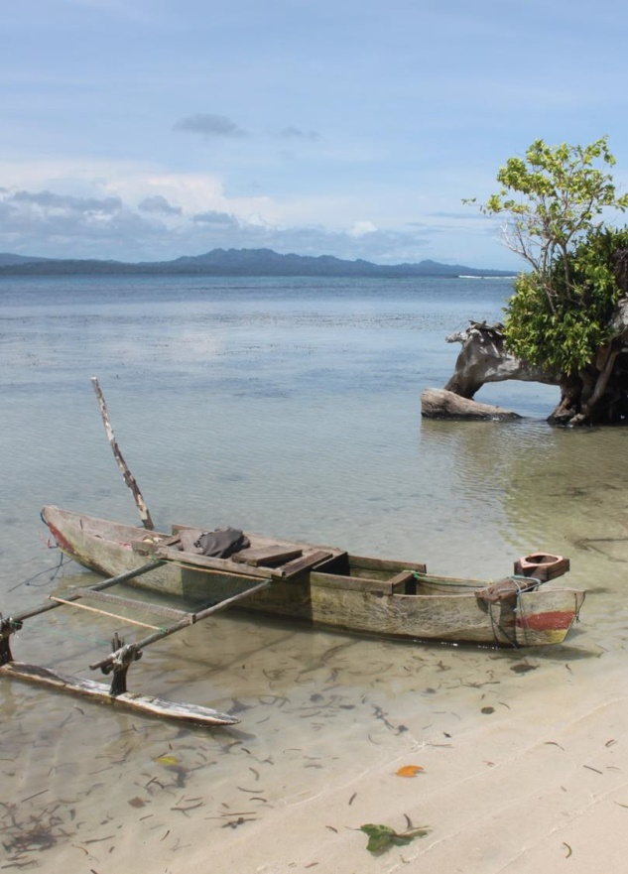
Presentation Outline
Technical Working Groups and Focal Points
CTI Goals Summary
Constrains/Issues/Challenges Affecting Implementation of Identified Activities
National Road MAP 2019
Potential Regional Program and Support Required
Documents/Materials/Publications
Other Remarks

Slide 3
Technical Working Group Members / Agencies
Technical Working Groups
Seascapes | The Technical Working Group Focal Point is CEPA Co-Chair is TNC
EAFM | The Technical Working Group is NFA Co-Chair is CEPA
MPA | The Technical Working Group is CEPA Co-Chair is TNC
CCA | The Technical Working Group is CCDA
Threatened Species | The Technical Working Group is CEPA
Governance Working Groups
FRWG | The Technical Working Group is CEPA Co-Chaired by NN, DFAT
CMWG | The Technical Working Group is CEPA Co-Chaired by NCC, TNC
MEWG | The Technical Working Group is CEPA Co-Chaired by NCC, NFA

Slide 4
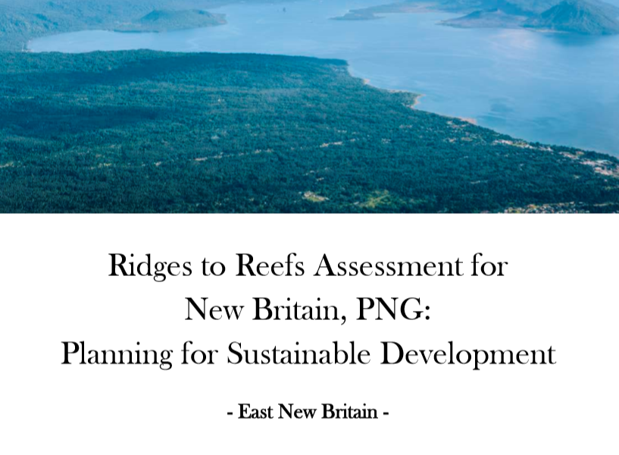
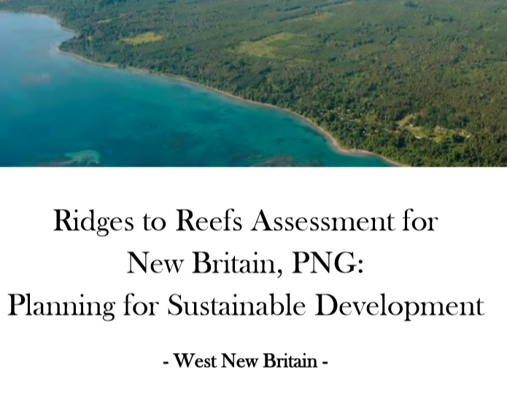
I. Progress/Achievements Towards NPOA
SEASCAPE
BISMARCK SEA SEASCAPES PLANNING
Background : WWF has provided technical input into the nomination document for the Bismarck Solomon Seas Ecoregion nomination as a priority seascape for the CTI-CFF.
(2015-2017) Design & build decision-making tools and processes to enable better consideration of potential social and environmental benefits and costs of large-scale development across land and sea in the Bismarck Sea.
Partnership - CEPA, TNC, CSIRO , provincial & Local Level governments, industries and communities..
Focus on East New Britain (ENB) and West New Britain (WNB), bordering the eastern part of the Bismarck Sea (Figure 1) due to the large scale developments in the region.
Funding support from Australian Government.
Available from worldwide web at: https://research.csiro.au/bismarcksea Website also includes additional appendices, project details, workshop presentations, and other related reports.

Slide 5
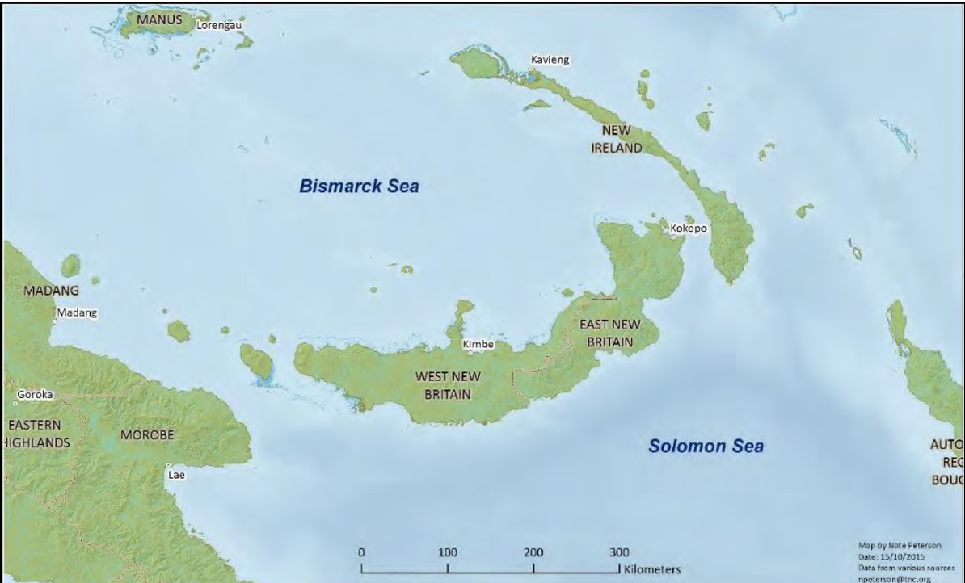
I. Progress/Achievements Towards NPOA
SEASCAPE Project goal: To “improve capacity for strategic decision-making for sustainable and responsible economic development in New Britain and the eastern Bismarck Sea”.
The Bismarck Sea
A priority for CEPA under CTI Seascapes Goal 1 Has abundant natural resources including fish, reefs and mineral deposits.
There are many opportunities for large-scale mining, agriculture, fisheries and tourism which, if developed without adequate foresight, could impact upon future livelihood and conservation objectives and values of the region.
‘Seascapes’ planning applied to assist decision-makers to responsibly consider potential intended and unintended consequences of development on all stakeholders and account for future uncertainties such as climate change.
In addition, understanding and managing potential linked impacts of different developments (e.g. from land to sea).
Notes:
In addition, understanding and managing potential linked impacts of different developments across space (e.g. from land to sea) and time (e.g. cumulative effects), which could result in unanticipated outcomes.
One component of a broader collaborative program, Building Capacity for Sustainable and Responsible Development in the Bismarck Sea, which contributes to Papua New Guinea’s (PNG) activities in the Coral Triangle Initiative for Coral Reefs, Fisheries and Food Security (CTI).
Under the CTI the Bismarck Sea is a priority geography as it holds globally-important marine biodiversity, and is also the focus for rapid economic development in its maritime provinces of East and West New Britain, New Ireland, Manus, Morobe and Madang.
Consequently, PNG’s Conservation and Environment Protection Authority (CEPA) has identified the Bismarck Sea as a demonstration site for integrated ‘seascapes’ planning, which is one of the CTI’s five goals.

Slide 6
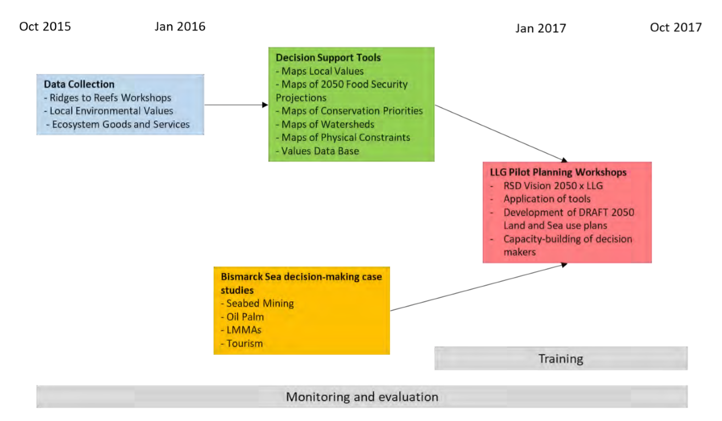
I. Progress/Achievements Towards NPOA
SEASCAPE
Four primary activities as shown in the figure provided:
Identification and collation of the environmental features and services that stakeholders value in New Britain,.
Assessments of decision-making processes and gaps in knowledge,.
Pilot planning workshops to investigate potential future development,.
A key need identified by participants was the need for LLG land and sea use plans.

Slide 7
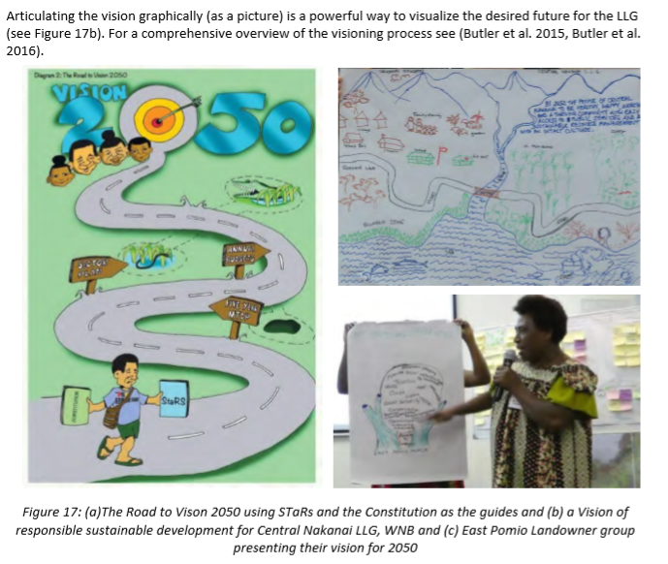
I. Progress/Achievements Towards NPOA
SEASCAPE
Project Results were:
1. Visioning exercises with each LLG developing their own visions. (Central Nakanai LLG Vision)

Slide 8
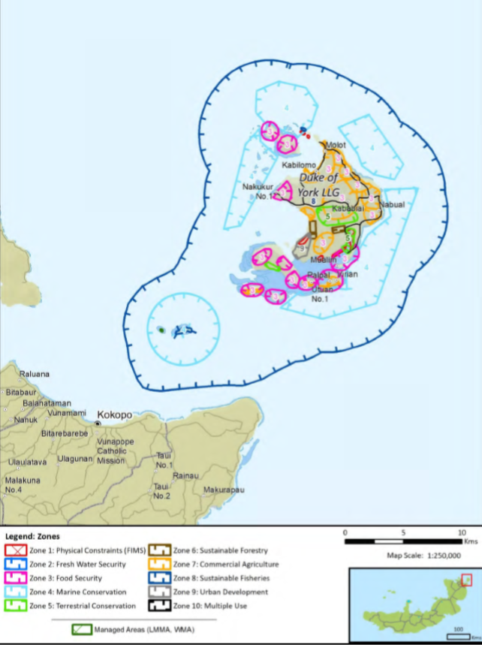
I. Progress/Achievements Towards NPOA
SEASCAPE
Project Result 2:
Zoning Report Cards were developed for each LLG and presented to them. Figure provided is a report card for the Duke of York LLG, located in East New Britain province, Bismarck Sea, PNG.
Notes:
The Islands are characterised by 13 islands with 7 major islands.
It lies in the straits of Saint Georges Channel between East New Britain and New Ireland. The largest Island (Duke of York) is mostly forested and low lying.
The islands have extensive nearshore reef systems and areas of mangrove on the south eastern side.

Slide 9
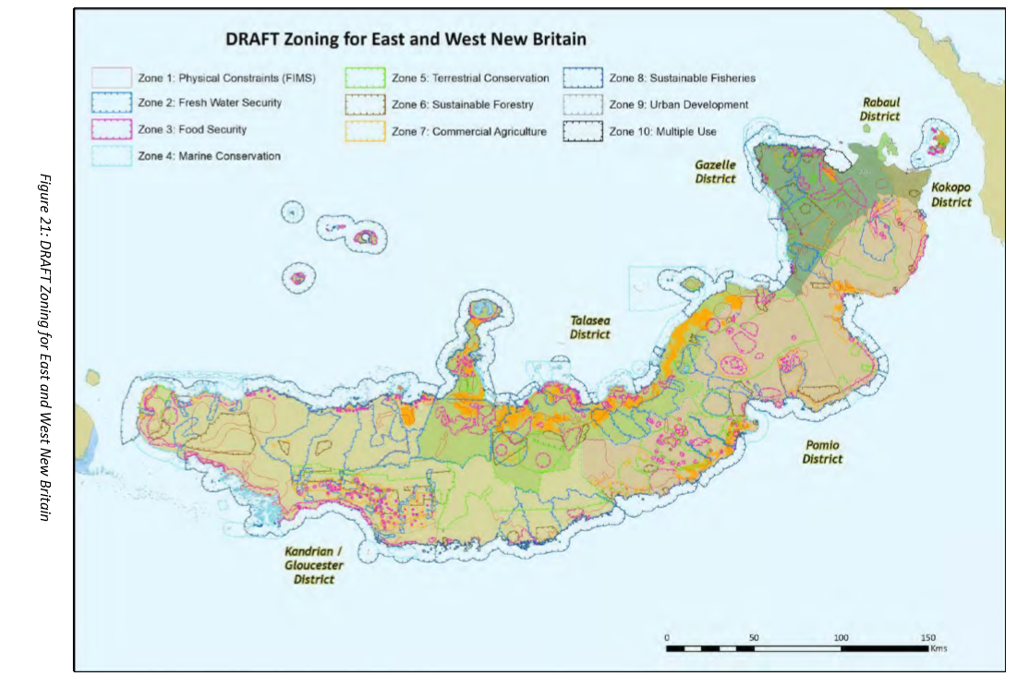
I. Progress/Achievements Towards NPOA
SEASCAPE
Key conclusions from the project are as follows:
1. Population-constrained LLGs –
2. Climate change adaptation –
3. Best practice for commercial agriculture –
4. Equity – when arable land is allocated to commercial operators, decision-makers need to be extremely aware of the long-term direct and indirect impacts of the proposed development.
Notes:
a number of LLG’s are already experiencing food and water shortages as well as a myriad of other problems associated with population pressure. These include the three island LLG’s Bali Witu, Watom and Duke of York, and some of the LLGs with significant Commercial and Village Oil Palm Estates such as Hoskins LLG. Population-constrained LLGs would all benefit greatly from proactive family planning initiatives to help alleviate both current and future pressures in these LLGs, as already highlighted by previous TNC-CSIRO work in WNB.
population-constrained LLG’s are also likely the most vulnerable to the impacts of climate change events and would benefit greatly from the development of climate change adaptation strategies to ensure food security and freshwater security during periods of drought as well as the potential impacts of sea level events for those communities in low lying areas. These have already been identified for Bali-Witu LLG in 2013, and strategies overlap and complement the land use zoning presented in the Report Card for this LLG.

Slide 10
I. Progress/Achievements Towards NPOA
EAFM
CTI-CFF NATIONAL PROGRAMS
Target # 1: Strong legislative, policy and regulatory frameworks in place for achieving an Ecosystem Approach to Fisheries Management (EAFM). This has been achieved. The Fisheries Management Act is being revised with assistance from FAO. Various fisheries management plans (BDM, marine aquarium trade, mud crab management plans etc) have been established with focus on EAFM.
Target # 2: Improved income, livelihoods and food security of an increasingly significant number of coastal communities across the region through a new sustainable coastal fisheries and poverty reduction initiative (“COASTFISH”). This has also been completed through ongoing programs such as the IFAD, Clean Seascape Program, Trap Net Program and Seaweed Farming Program.
Target # 3: Effective measures in place to help ensure exploitation of shared tuna stocks is sustainable, with tuna spawning areas and juvenile growth stages adequately protected. This target has also been completed with the recent establishment of the VMS for tuna fisheries. There is also ongoing tuna tagging program and stock assessment being done.
Target # 4: A more effective management and more sustainable trade in live reef fish and reef-based ornamentals achieved. There is currently a moratorium on live reef food fish trade in PNG. There was a management plan for the trade however this will be revised once there is a decision to reopen the trade. We have a Marine Aquarium Management Plan in place but still yet to be gazetted. There is a domestic market or trade of ornamentals however no exports have been made in the last few years.
EAFM
PROGRAMS / ACTIVITIES IN RELATION TO CTI-CFF GOALS (but not directly budgeted under national CTI-CFF programs)
1) Inshore Fish Aggregation Device
2) Clean Seascape Program (Coral rehabilitation project, Mangrove Reforestation project, Waste Management project)
3) Seaweed Farming program
4) Fish Trap Net Project
5) In Madang Province WWF implementing sustainable community-based fisheries co-management, linked to empowering women through financial inclusion.
6. Community based sustainable fisheries projects ( sea cucumber)
7. Sedentary marine resources assessment for Milne Bay province.
Notes:
We adopt an EAFM approach across the breadth of our work on coastal fisheries, incorporating food security, ecosystem approaches to resource management, vulnerability and adaptation planning, and protection of key species and habitats including mangrove protection and rehabilitation.

Slide 11
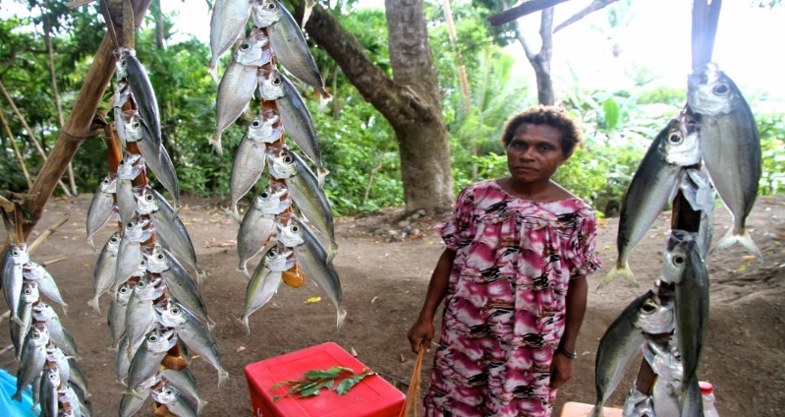
I. Progress/Achievements Towards NPOA
EAFM
PROGRAMS / ACTIVITIES IN RELATION TO CTI-CFF GOALS (but not directly budgeted under national CTI-CFF programs)
1) Inshore Fish Aggregation Device results in food security for families and income generation for local fisherfolk.

Slide 12
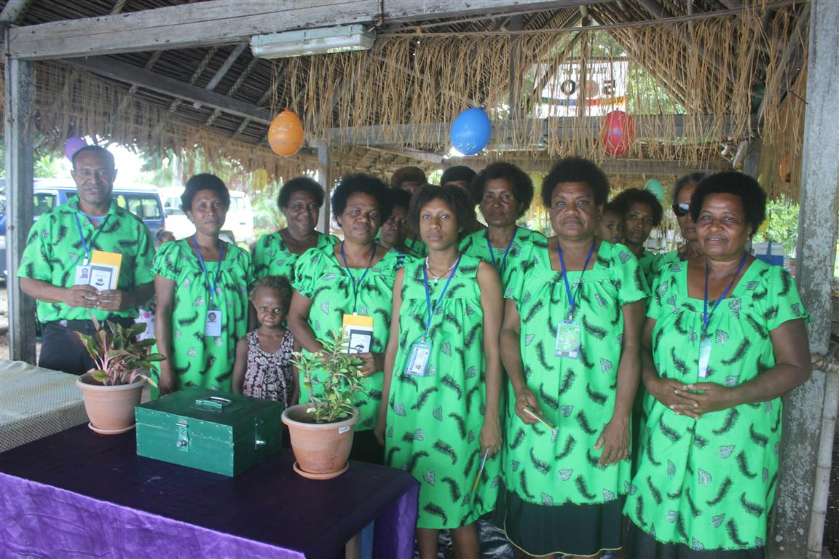
I. Progress/Achievements Towards NPOA
EAFM
WWF implementing sustainable community-based fisheries co-management, linked to empowering women through financial inclusion.
Rolling out in 15 Community Based Fisheries management communities in 3 districts of Madang Province (Madang, Sumkar, Bogia)
5 Village Savings groups
WWF supplies savings kits, passbooks, stationery, ID cards, locks/keys, savings box
Training Module developed for Field officers – a guide on how to establish savings groups.

Slide 13
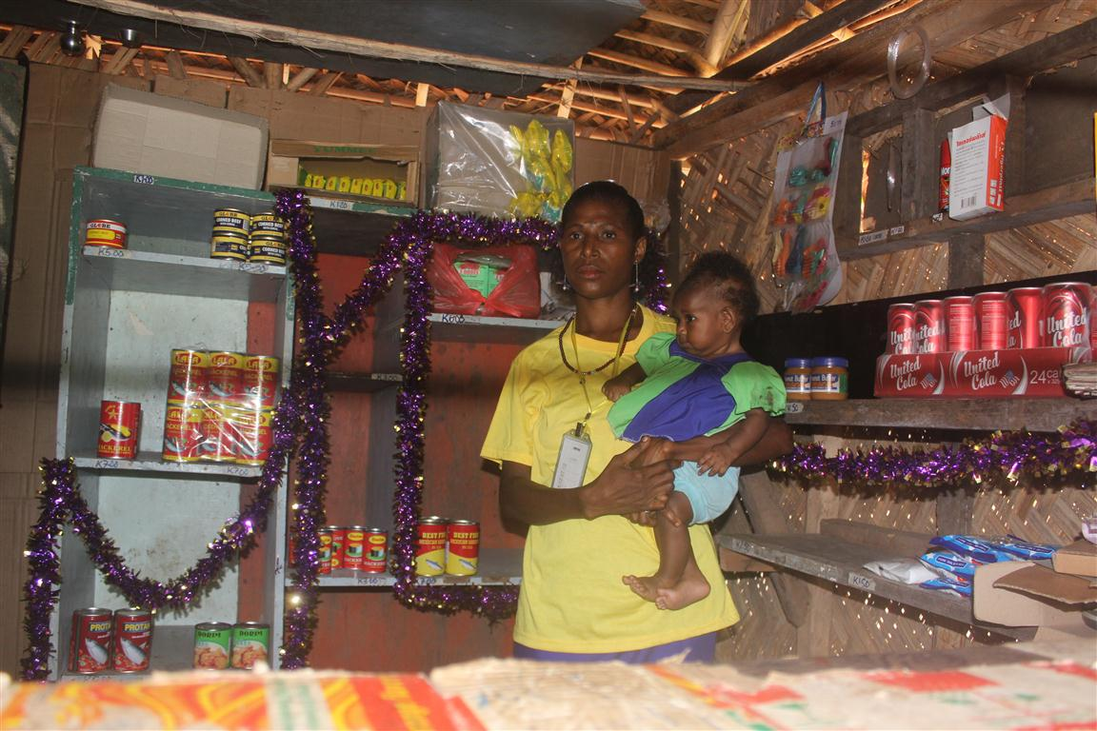
I. Progress/Achievements Towards NPOA
EAFM
Village Savings & Loan concept based on World Vision’s livelihoods programme
778 members, mostly women
Training on budget & loan management in simple grassroots language, provided in partnership with World Vision,
12,807 PGK (3,800 USD) in group savings; 15-20 micro businesses established.
Members taught banking at their doorsteps, how to get loans from their savings.
Meetings held weekly/fortnightly based on members constitution law
6 monthly meetings to capture challenges experienced, lessons learnt, way forward for improvement.
Sustainability criteria (environmental; socially, ethically; financially) included in saving clubs constitutions & loans

Slide 14
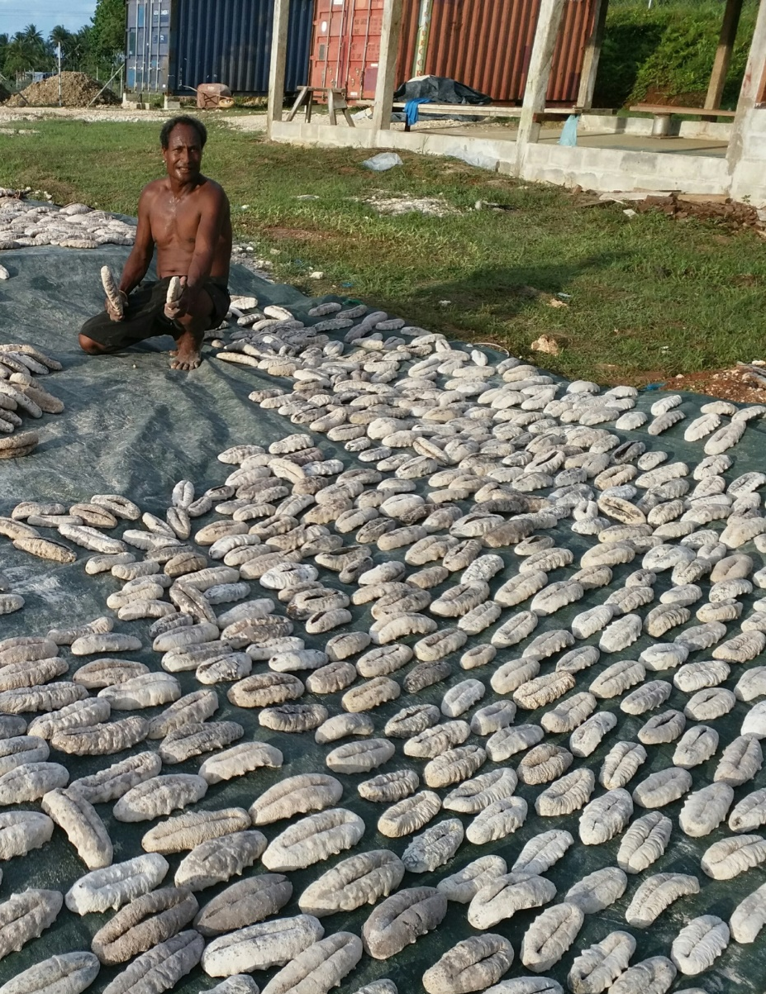
I. Progress/Achievements Towards NPOA
EAFM
CTI-CFF NATIONAL PROGRAMS
In Manus province, one tribal group and their local communities are working to sustainably harvest sea cucumber (sand fish and white teat) resources from their LMMAs during the open season and exporting directly to Hongkong markets to support livelihoods.
TNC supported the Licensing & Accreditation, of Menar Co-op to own a BDM exporter licence
Co-op is WWF sustainable certified
Ongoing relationship with premium BDM wholesaler in Hong Kong
TNC supports Ongoing socio-economic and ecological assessment
Menar Co-op earned 240% returns from a business as usual model

Slide 15
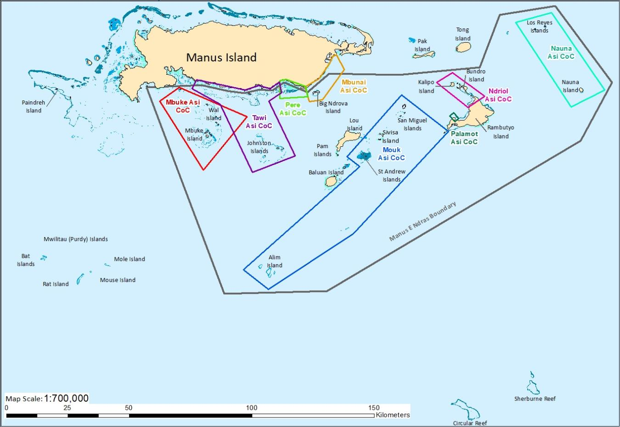
I. Progress/Achievements Towards NPOA
GOAL # 3 MPAS
CTI-CFF NATIONAL PROGRAMS
1. Bootless Bay Marine Conservation Initiative in the National Capital District.
2 .Kimbe Bay MPA/LMMA Network in the West New Britain province (Bismarck Sea)
3. In Madang province WWF has worked with local communities to establish community based management areas.
4. In Milne Bay province, Eco Custodians Advocates working with communities to set aside community based management areas using traditional customs.
5. In Manus province, 3.5 million hectares set aside using a mix of LMMA management planning process & traditional management.

Slide 16
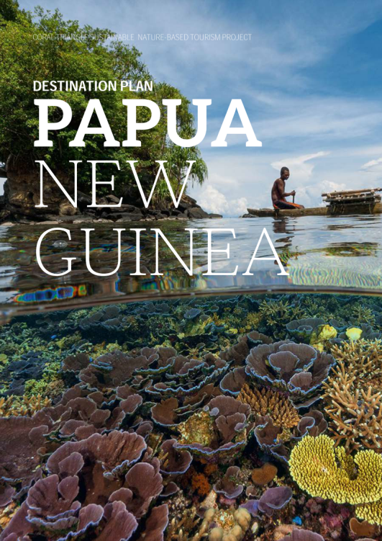
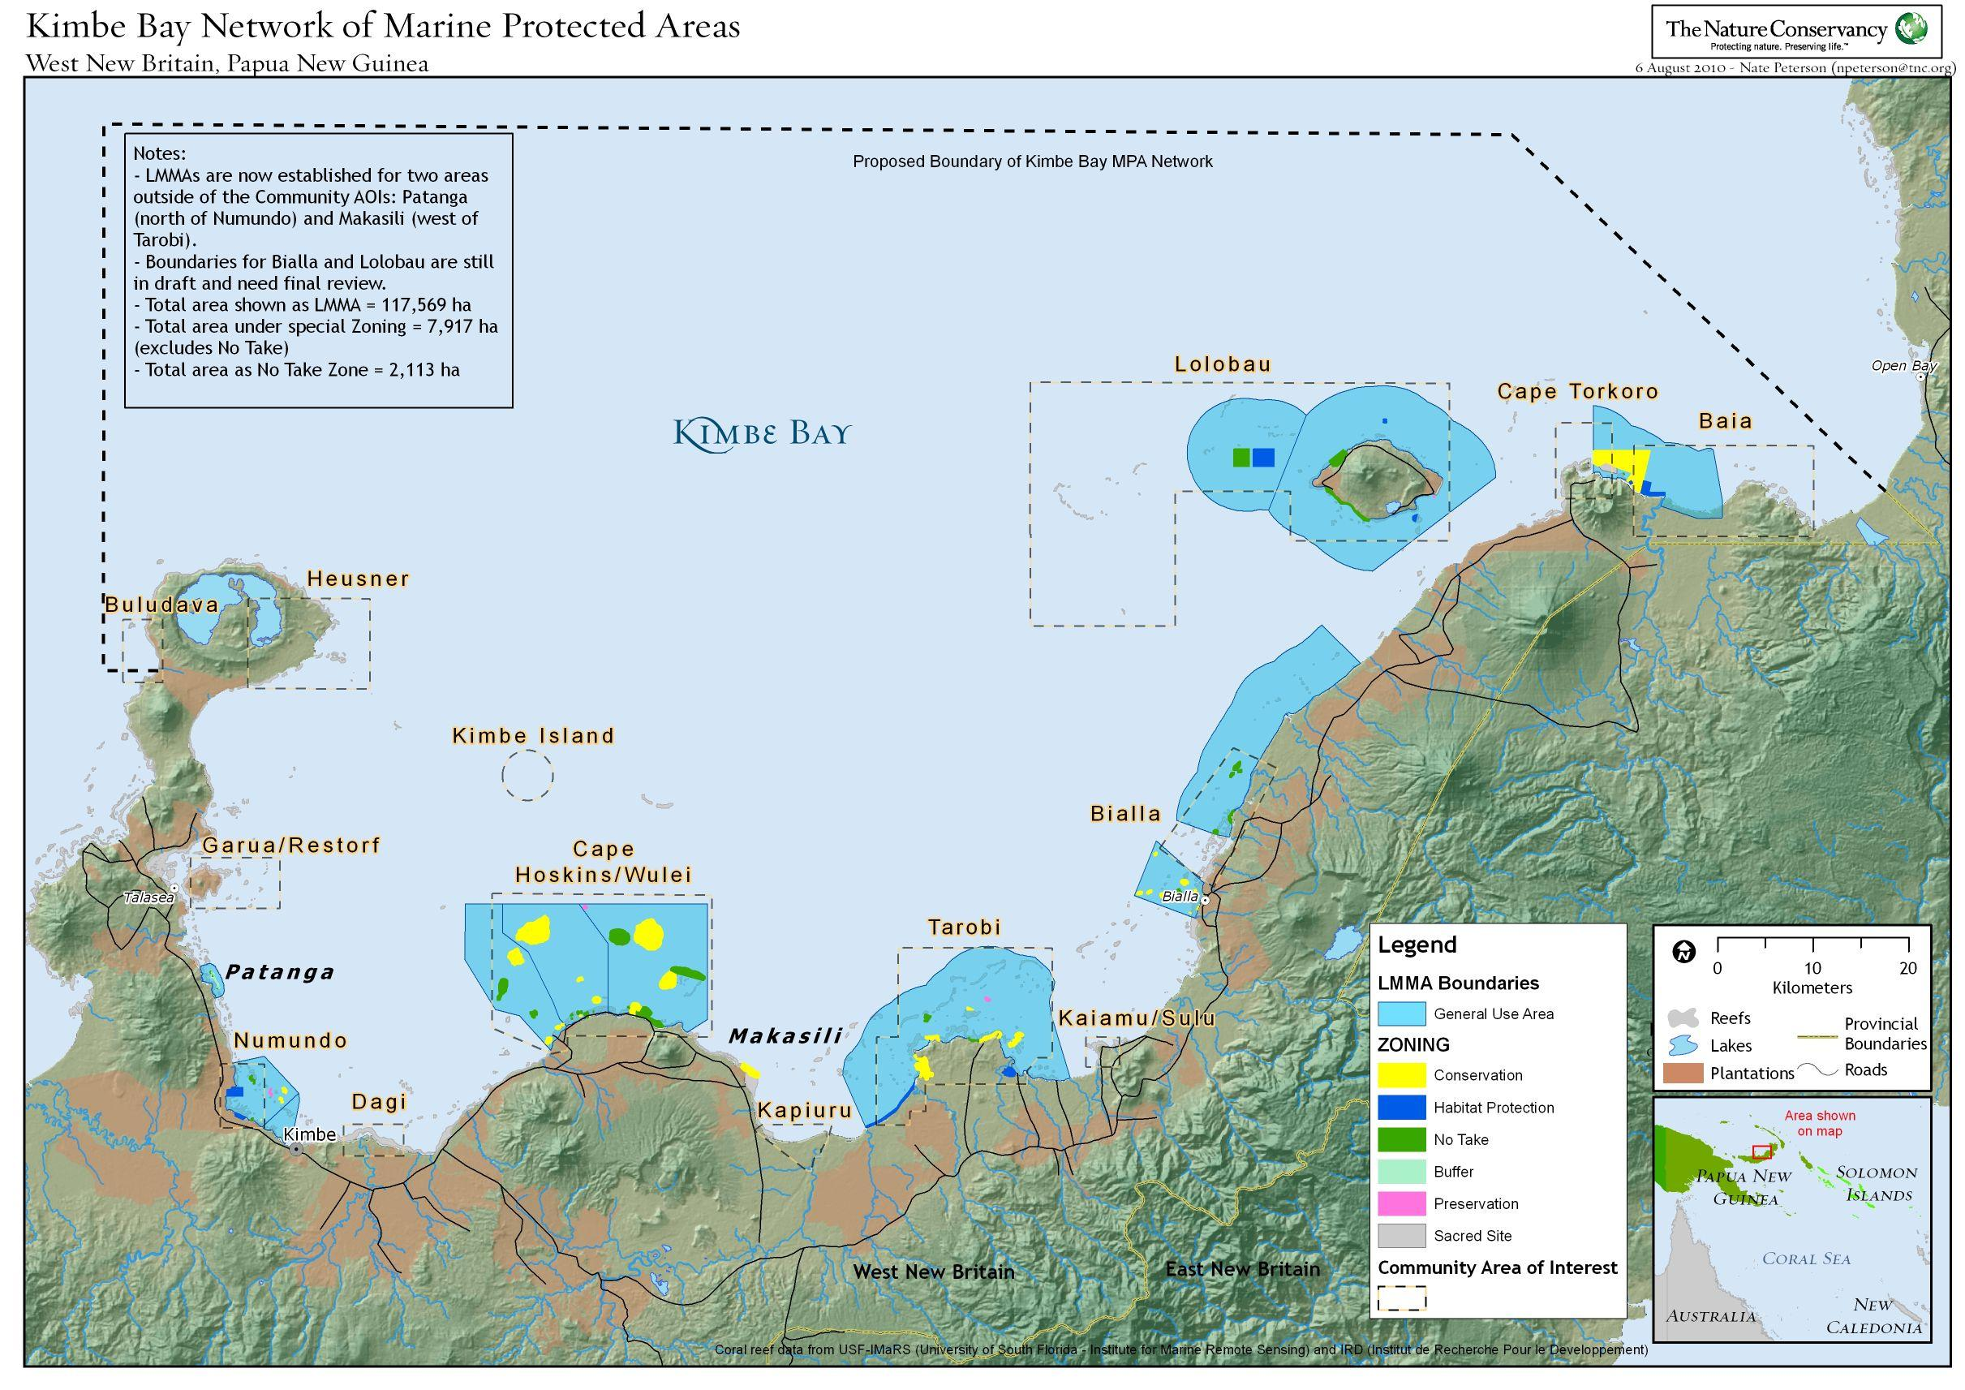
I. Progress/Achievements Towards NPOA
MPAS
WWF & the Government of Australia implemented the Sustainable Nature-based Tourism in the Coral Triangle Project. Included the development of a destination plan for Kimbe Bay, West New Britain as a signature destination for sustainable tourism in the Coral Triangle.

Slide 17
I. Progress/Achievements Towards NPOA
CLIMATE CHANGE ADAPTATION
CTI-CFF NATIONAL PROGRAMS
1. Coastal & Inland Flooding early warning systems established
Established in 5 provinces for observation, data collection and information management and dissemination
2. Community-led mangrove reforestation and conservation
Projects supported
3. Climatic Risk and Vulnerability maps produced for 5 Maritime
Provinces – risk profiling done for all the districts
4. Institutional capacity at national and sub-national levels to integrate climate change-related risks into sectoral policies and management practices strengthened
5. Reviewing & publication of the community-based mangrove handbook
CLIMATE CHANGE ADAPTATION
PROGRAMS / ACTIVITIES IN RELATION TO CTI-CFF GOALS (but not directly budgeted under national CTI-CFF programs)
1. WWF is building community and marine resource resilience through its Community-based Fisheries Co-management approach and its focus on mangrove protection and rehabilitation in Madang Province.
2. In Ahus Island , Manus province TNC implemented a Climate Change & Adaptation project and trained women on soil improvement methods to get quality yields of vegetables and greens.
3. Mangoro Market Meri - Led by The Nature Conservancy, it is a platform for empowering women to generate income based on sustainable management of their mangroves. Potential economic opportunities include
i. Connecting women to markets for sustainably harvested mangrove products such as shellfish , mud crabs (short-term)
ii. Exploring potential for ecotourism (medium-term)
iii. Preparing to engage in clean cookstoves to lower carbon emissions (long term)
4. Led by the University of PNG, in Suau, District of Milne Bay province, Blue Carbon and REDD + strategy.

Slide 18
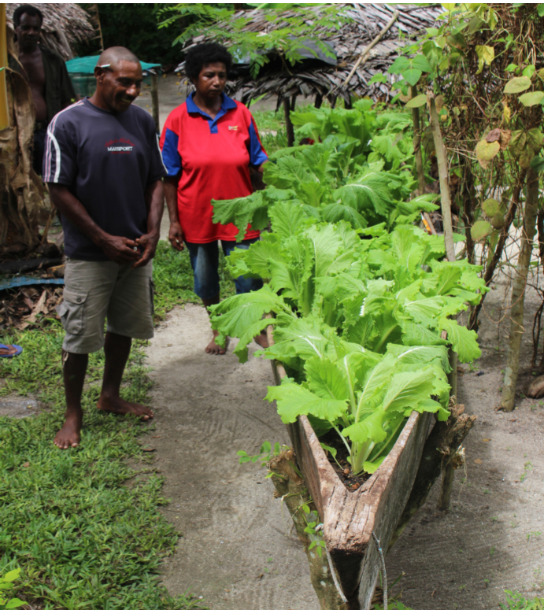
I. Progress/Achievements Towards NPOA
Climate Change Adaptation & Food security project in Ahus Island, Manus province, PNG. (German BMU)
Issue: Rising sea levels & Salt water intrusion.
Solution: Women trained by Agriculture officers to improve their soils using compost and grow vegetables/greens as shown in the picture.
Women also generated income by selling some of these vegetables to established supermarkets.

Slide 19
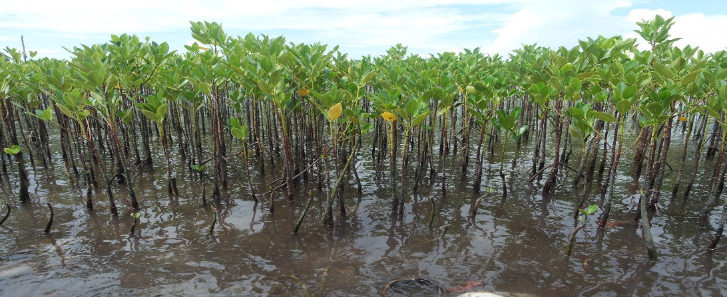
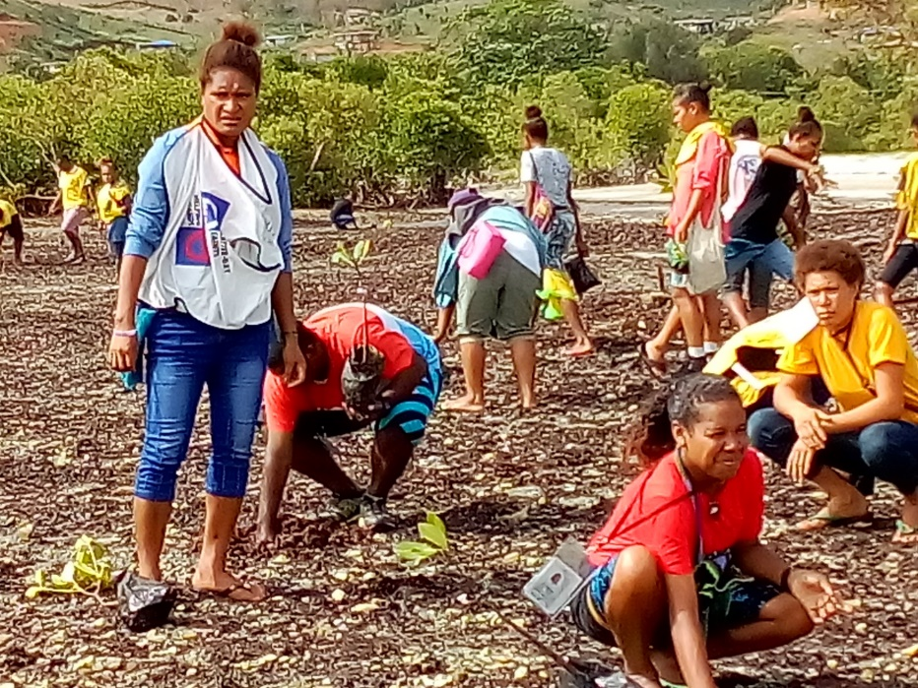
I. Progress/Achievements Towards NPOA
Climate Change Adaptation
Ongoing Mangrove Planting projects in different parts of the country.
Youth in Port Moresby support mangrove planting initiatives. Photo credit: TNC
Mangrove rehabilitation in the Central province, PNG. Photo credit: PNG CLMA.

Slide 20
I. Progress/Achievements Towards NPOA
THREATENED SPECIES
CTI-CFF NATIONAL PROGRAMS
1. A National Database listing of all the threaten species has been compiled & prepared for endorsement by PNG NCC to be circulated for confirmation by all stakeholders.
2. The Marine Mammals & the Marine Turtles Species Management Plan outline has been confirmed , drafting has commenced with completion by end of 3rd Quarter of 2019
3. The Review of the PNG Marine Program 2018 – 2022 will allow the Threaten Species Goal to become more focussed on Capacity building for the 14 maritime provinces (9 priority province-2018/19)
4. A full scale educational awareness program will be conducted for the 9 priority province addressing specific subject of biology, conservation, habitats, migratory pathways, feeding & foraging sites, telemetry, threats both natural and anthropogenic,
5.All threaten Species occurring PNG waters been mapped and described, including conservation, habitats, migratory pathways, feeding & foraging sites, telemetry, threats both natural and anthropogenic
6. PNG is updating its information on the International Marine Mammal Assessment throughout the country.
THREATENED SPECIES
PROGRAMS / ACTIVITIES IN RELATION TO CTI-CFF GOALS (but not directly budgeted under national CTI-CFF programs)
1. Freshwater dolphin research that is currently conducted jointly by the James Cook University and Exxon Mobil PNG Ltd project in the Gulf province
2. Major campaign on the marine plastic pollution around coastal provinces starting in Port Moresby. Focussed mainly on local markets, major shopping centres, and recreational beach picnic areas.
3. Management plans for other threaten marine species which the NFA and CEPA will work closely to produce on all commercial species both sedentary and finfish.
4. WWF has provided information to the TSWG including reports; research and strategies for key threatened species. A
5. Rapid Assessment Tool for Sharks & Rays and an MPA guide for the effective design and management of MPAs for Sharks & Rays. This is additional to the 2017 Responsible Shark and Ray Tourism - Best Practices Guide.

Slide 21
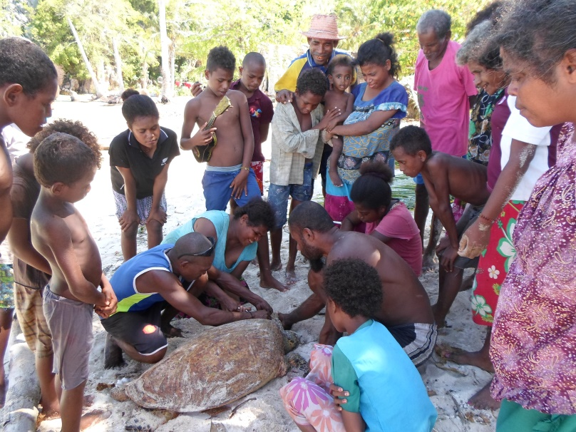
I. Progress/Achievements Towards NPOA
THREATENED SPECIES
CTI-CFF NATIONAL PROGRAMS
Jomard Passage Community Based Turtle Monitoring in the Milne Bay Province.

Slide 22
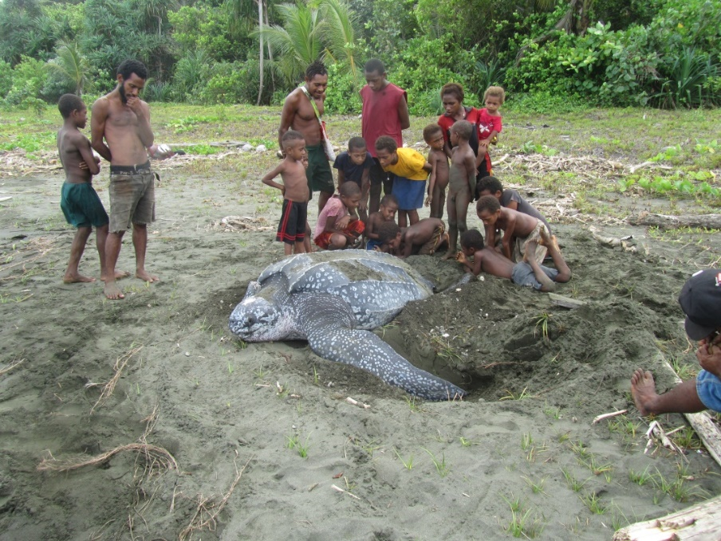
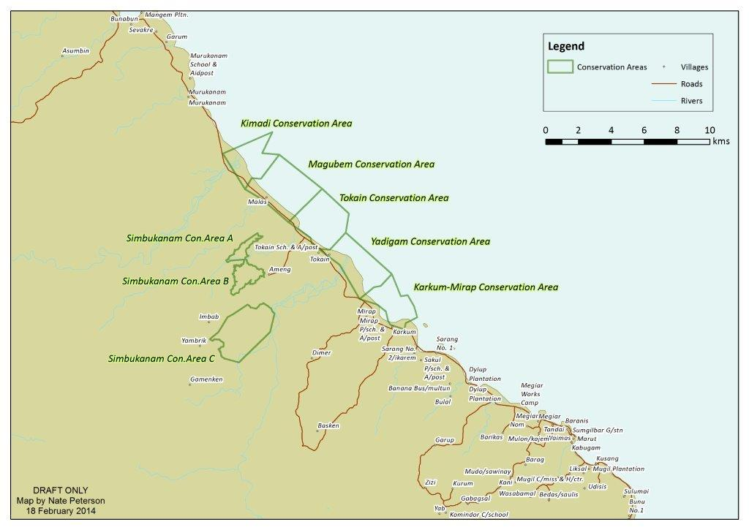
I. Progress/Achievements Towards NPOA
THREATENED SPECIES
CTI-CFF NATIONAL PROGRAMS
In Madang province , a community based organisation Mas Kagin Tapani, is working with local communities to protect their beaches to save leatherback turtles through conservation deeds.

Slide 23
II. Constraints/Issues/Challenges Affecting Implementation of Identified Activities
Limited timelines for implementation, (a one year project is unlikely to meet its objectives.)
Capacity issues at the PNG NCC has often led to lack of coordination of activities amongst stakeholders (Finances, manpower etc.)
Governance & political will
Delay in the enactment of the Protected area bill
Sustainable financing for the PNG Marine Program (NPoA)
Need for improved partnership dialogue between all 14 maritime provinces & other stakeholders (Maritime Governors Roundtable)
Lack of communications/gender strategies to support the implementation of the NPoA

Slide 24
III. National Roadmap 2019
CTI-CFF National Programs
Launching and marketing of the PNG Marine Program ( NPOA)
Enactment of PA Bill
Rolling out of biodiversity courses by UPNG. (Post Grad, Masters, Certificates)
Mapping of all marine species / data base
Upgrading of PNG Protected Areas (Marine & Terrestrial)
Hosting the Governors Roundtable for 2019.
B. National Programs in relation to CTI-CFF RPOA goals but not budgeted as CTI-CFF programs
Sedentary marine resource assessment and blue carbon
Oceans program
Partners programs (WWF, WCS, TNC and other national NGOs & institutions)
Mapping of Shark and Rays Distribution.

Slide 25
III. National Roadmap 2019
National Plan of Action Review (if any)
Please state the outcome of the NPOA Review, and if NCCs are planning to review the NPOA, what are the expectations from the review that would be useful for the RPOA 2.0 development in 2019.
Summary of Major Outputs
Papua New Guinea NPoA will now be aligned with the country MTDP III 2018-2022
Bismarck Seascapes Planning informing key stakeholder in key strategies to take to inform decision making for major development plans.
EAFM - Increased momentum around management that adds value to food security, and livelihoods
MPA - Development of the Protected Area Bill
Climate Change Adaptation - Development of the Climate Change Policy & Act ( MTDS)
Threatened Species - Increased ownership by local communities of Community based management initiatives particularly with marine turtles and dugongs.

Slide 26
IV. Potential Regional Program & Support Required
Informed Data base program coordinated by SPREP and CEPA
Mapping & GIS project to develop the PA registry for PNG
National Rangers Program led by CEPA under GEF
BSSE Eco Region planning
Profiling LGN and WLF commitments across PNG
Support required for the campaign against the Plastic marine pollution.

Slide 27
V. Documents/Materials/Publications
Ridges to Reefs Assessment for New Britain, PNG: Planning for Sustainable Development East New Britain (Geoff Lipsett Moore et al, 2017)
Ridges to Reefs Assessment for New Britain, PNG: Planning for Sustainable Development West New Britain (Geoff Lipsett Moore et all, 2017)
Papua New Guinea Ahus Island Report Card Based on UN Sustainable Development Goals, Nov 2018
Sharks and Rays of Papua New Guinea by William T White, Leotine Baje. Benthly Sabub, Sharon A. Appleyard, John J Pogonoski and Raph R Mana
Reports & Presentations from all implementing partners & institutions (WWF, TNC, WCS, UPNG, PNGCLMA, MAKATA , ECA, etc)

Slide 28
VI. Other Remarks
Acknowledge the funding support of our Development Partners, (USAID, Government of Australia, German BMU, ADB, UNDP,) without whom many of the projects would not have been implemented.
Acknowledge the support of our partners who are implementing the programs in the field. (WWF, WCS, TNC, CTC, PNGCLMA, MAKATA, and many others)
Acknowledge the support of the CTI Regional Secretariat and the TWGs
Acknowledge the friendship & commitment of all the CT6 countries. (Thank you Philippines for your warm hospitality in hosting this SOM)
Acknowledge the vibrant traditional knowledge and customs of our ancestors who have for thousands of generations managed these finite resources for us .
We call on all of us today to do our part as did our ancestors in upholding the laws of our lands and the commitments under the CTI to protect and manage our Coral reefs and fisheries for our future generations in the region & globally.

Slide 29
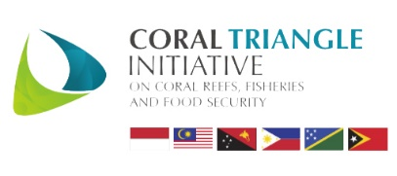
Terima Kasih - Maraming Salamat Tank Iu- Obrigado Tagio Tumas
Photo credits: IYORBank_Rebecca Weeks and Yen-Yi Lee

