Slide 1
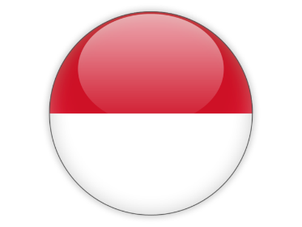
SOM14
14th Senior Officials’ Meeting
12-13 December 2018
Manila, Philippines
INDONESIA COUNTRY REPORT

Slide 2
Topic Outline
Progress/Achievements Towards NPOA
Constraints/Issues/Challenges Affecting Implementation of Identified Activities
National Roadmap 2019
Potential Regional Program & Support Required

Slide 3
Technical Working Groups
Seascapes
Director of Marine Spatial Planning, Ministry of Marine Affairs and Fisheries / Assistant Deputy for Maritime Services, Coordinating Ministry of Maritime Affairs
EAFM
Director of Fish Resources Management, Ministry of Marine Affairs and Fisheries / Assistant Deputy for Biological Resources, Coordinating Ministry for Maritime Affairs
MPA
Director of Marine Conservation & Biodiversity, Ministry of Marine Affairs and Fisheries
CCA
Director of Climate Change Adaptation, MoEF
Threatened Species
Director of Marine Conservation & Biodiversity, Ministry of Marine Affairs and Fisheries
Governance Working Groups
FRWG
Director of Asia-Pacific and African Intra-Regional Cooperation, Ministry of Foreign Affairs Republic of Indonesia
CMWG
Director for Marine and Fisheries, Ministry of National Development Planning / Bappenas
MEWG
Asisstant Deputy for Environment and Maritime Disaster, Coordinating Ministry of Maritime Affairs
National Focal Points

Slide 4
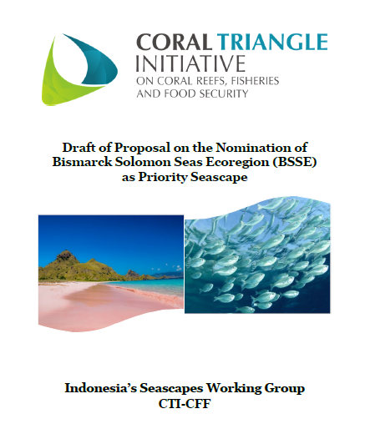
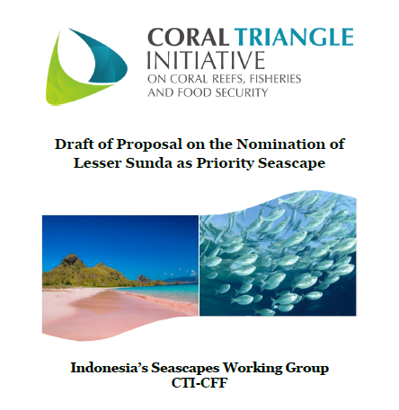
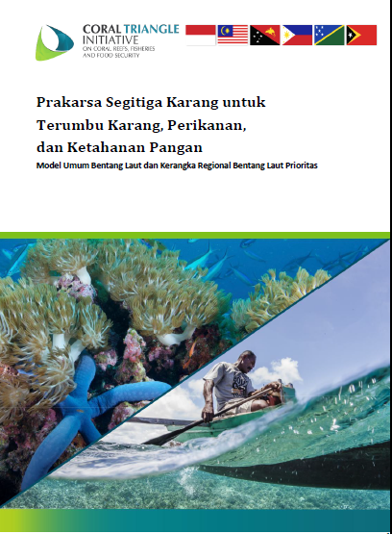
I. Progress/Achievements Towards NPOA
SEASCAPES
The Seascapes Documents
Lesser Sunda and Bismarck Solomon Seas Ecoregion
Rules and Procedures of CTI-CFF Seascapes Working Group
14 Provincial Marine Spatial Plans
6 inter-regional Marine Spatial Plans

Slide 5
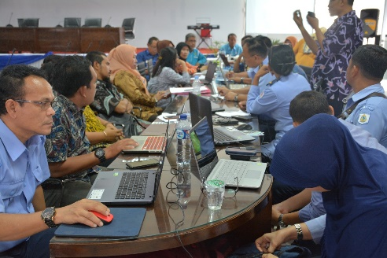
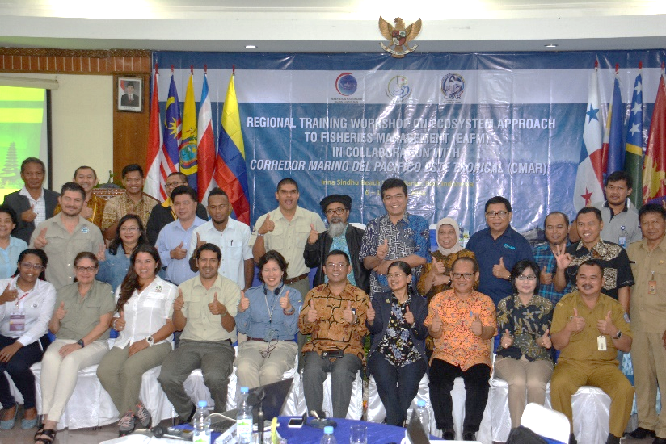
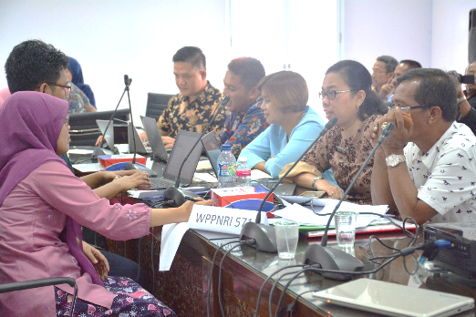
I. Progress/Achievements Towards NPOA
ECOSYSTEM APPROACH TO FISHERIES MANAGEMENT (EAFM)
Ministrial Decree on Establishment Fisheries Management Council
Ministerial Decree on Tuna, Skipjack, and Neritic Tuna Management Plan
Adoption and implementation of various international and regional regulation on Tuna
Workshop on EAFM in Collaboration with CMAR August 2018
Capasity Building on post-harvest in small scale fisheries and also EAFM Implementation
Diversification and business development in Ternate and establish community based capture fisheries enterprise in 34 Provinces
Observer on Board in place
Implementing E-Logbook

Slide 6
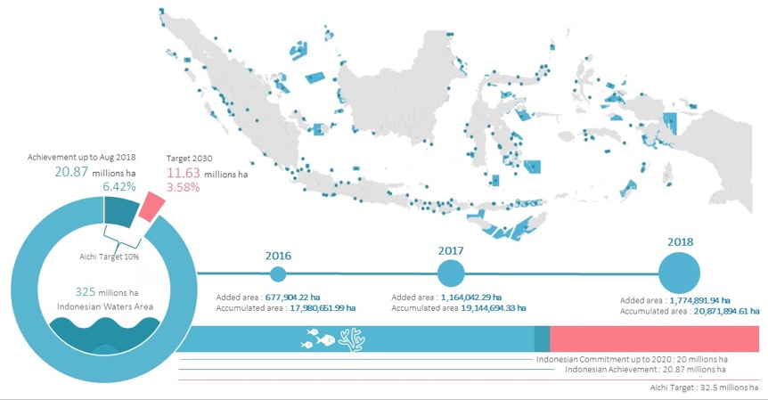
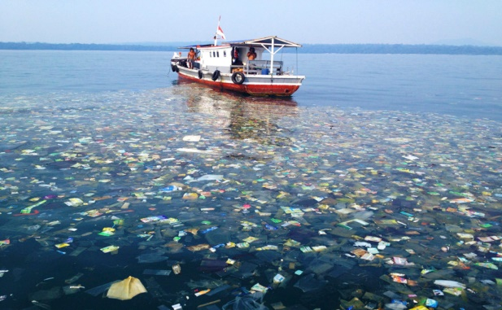
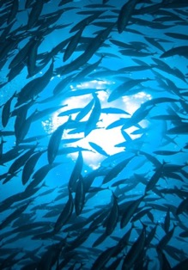
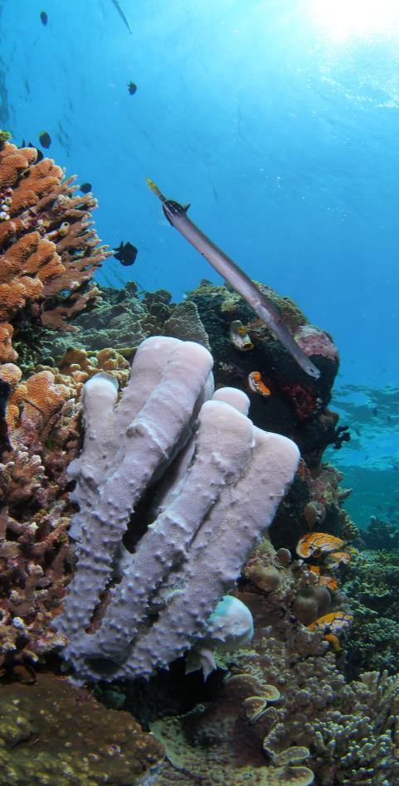
I. Progress/Achievements Towards NPOA
MPAs
4 Actions:
1,7 mil ha
MPA Network
Participatory process on MPAs planning and management
effectively-managed national marine protected areas system.
Training and Socialization:
Gita Laut, Youth Ocean Camps, Beach School
Training MPA’s sustainable financing, competency and training of trainer
The enactment:
- Preparation on legalization of sustainable marine protected areas management

Slide 7
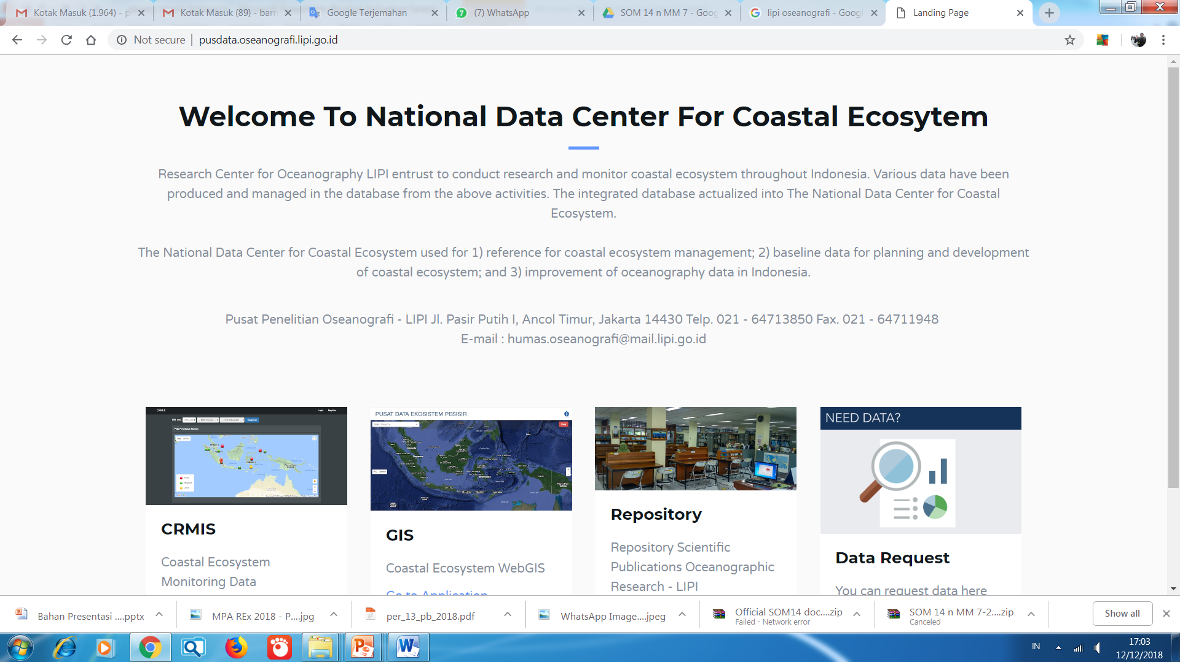
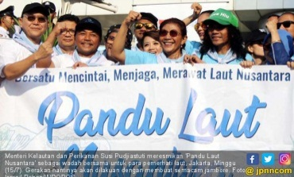
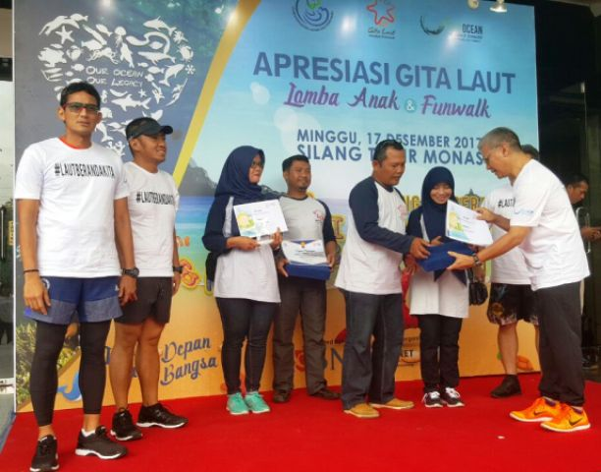
I. Progress/Achievements Towards NPOA
CLIMATE CHANGE ADAPTATION
CTI-CFF NATIONAL PROGRAMS
Workshop Low Carbon Development Plan and Climate Resilience
Workshop on Indonesia Blue Carbon Strategy Framework
5th Our Ocean Conference : Climate Related Impacts to the Ocean
One Map Policy:
Mainstreaming CCA
Climate Budget tagging
Climate Adaptation Campaign : Gita Laut, Pandu Laut, Coastal Youth Camp
Research on Climate Impact on the Ocean and Fisheries
Community and Ecosystem based Climate Adaptation Program : Program Kampung Iklim (Proklim), PKPT, APIK, SPARC
Indonesia Climate Change Trust Fund: Project on Increase Community Resilience towards Disaster and Climate Change in Lembeh Island and Likupang Beach, North Sulawesi

Slide 8
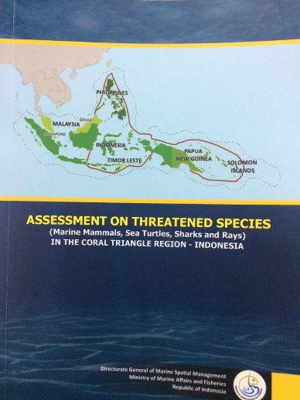
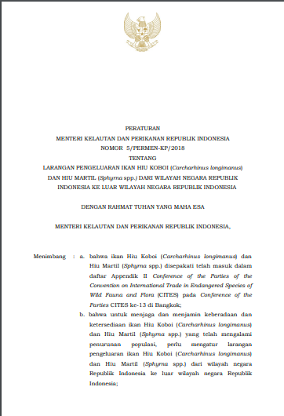
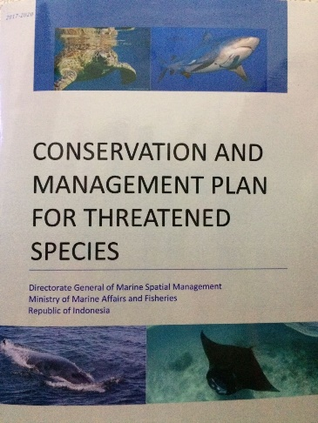
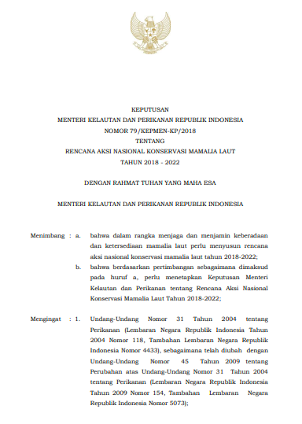
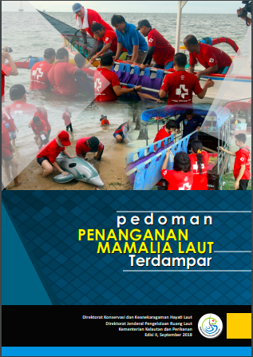
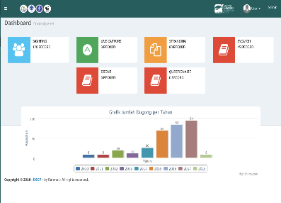
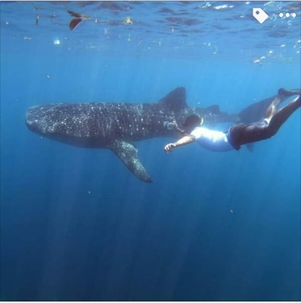
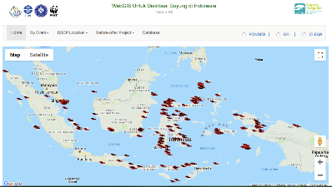
I. Progress/Achievements Towards NPOA
THREATENED SPECIES
National assessment reports and national conservation plans on threatened species (sharks and rays, sea turtles and marine mammals);
National Plan of Action on Marine Mammals Conservation through Minister of Marine Affairs and Fisheries Decree Number 79 Number 2018;
Export ban for Hammerhead Sharks and Oceanic Whitetip Shark through Minister of Marine Affairs and Fisheries Regulation Number 5 Year 2018 ;
Guideline of Survey and Monitoring for Dugong and Seagrass;
Satellite tagging for whale shark in West Papua and Sumbawa;
Guideline for stranded marine mammals handling
Manta Ray Population monitoring in West Papua;
Bycatch mitigation study for Mobula using LED in East Flores; and
WebGIS for dugong and seagrass distribution http://db.oseanografi.lipi.go.id/dugong
Accoustic tagging for whale sharks in Gorontalo; and
Photo ID monitoring for whale sharks in Berau.
1
3
2
4
4
6
9
11

Slide 9
II. Constraints/Issues/Challenges Affecting Implementation of Identified Activities
Seascapes management
Finding effective coordination mechanism with other countries relates to the management of priority seascapes
Marine debris and pollution
Harmonize regulations, programs and data accessibility related to CCA among the various authorities and other stakeholders
Habitat degradation and conversion
Irresponsible and unsustainable tourism management
Monitoring, control and surveillance toward certain species in some locations

Slide 10
III. National Roadmap 2019
Initiate the planning of priority seascapes
Develop regulations and national guidances relates to CTI-CFF goals
Monitoring and Evaluation on NPOA Implementation
Developing integrated and updated database system relates to CTI-CFF goals
Socialization and capacity building on issues/concerns relates to CTI-CFF goals
Campaign on community awareness on Climate Change
Strengthening Fisheries Management Councils (FMCs) based on EAFM and Fisheries Co-Management (FCM)
National Marine Spatial Plan
Network of MPAs at national and regional levels

Slide 11
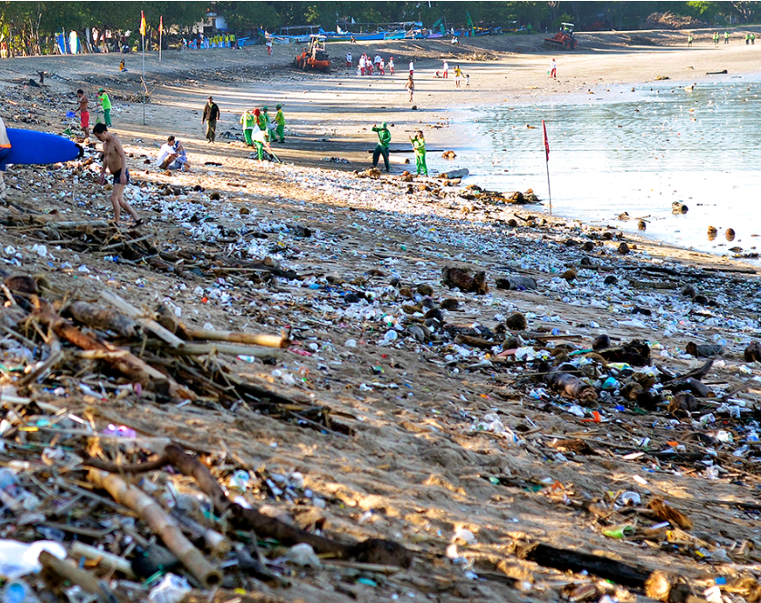
IV. SUCCESS STORY
1. Woman Empowerment Project:
“Addressing the Issue of Coral and Beach Sand Mining in Banda Islands, Indonesia through Community based Approaches”
2. National Plan of Action Combating Marine Debris

Slide 12
IV. Potential Regional Program & Support Required
Planning documents for priority seascapes
Capacity building
Integrated database system on CT Atlas
Joint project/activities and research amongst CT6 countries
Promote the CTI-CFF in the global network
Promote EAFM Plan
Program Harmonizations among working groups
Funding
Technical assistance
Support required

Slide 13
V. Documents/Materials/Publications
Model Umum Bentang Laut dan Kerangka Regional Bentang Laut Prioritas (Seascapes Document in Bahasa)
Chairman’s Summary of Multilateral Meeting on the Nomination of Lesser Sunda and BSSE as Priority Seascapes
Chairman’s Summary of the 5th CTI-CFF Seascapes Working Group Meeting
The Rules of Procedures of CTI-CFF Seascapes Working Group
Guidelines for turtle by-catch handling on fishing activities
Guidelines for turtle identification and population monitoring
National conservation plans for threatened species
National assessment reports on threatened species
Guideline for stranded marine mammals handling
Guideline Research on Carbon Budget in Seagrass Ecosystem
Guideline of Survey and Monitoring for Dugong and Seagrass
Guideline for Whale Sharks Tourism
MMAF Decree Number 79 Number 2018 regarding National Plan of Action on Marine Mammals Conservation
MMAF Regulation Number 5 Year 2018 regarding export ban for Hammerhead Sharks and Oceanic Whitetip Shark
Strategic Planning and Action To Strengthen Climate Resilience of Rural Communities (SPARC) document

Slide 14
VI. Other Remarks
Develop RPOA 2.0 adapted to current conditions
CT Atlas and CoE should for all TWGs related to stakeholders
Acknowledge the support of GIZ in Sulu-Sulawesi Seascape Project, which is ending this month.
Arising issue on Marine Debris as common threat should be anticipated and consider as common program for CT-6 countries

Slide 15
Terima Kasih - Maraming Salamat Tank Iu- Obrigado Tagio Tumas
Photo credits: IYORBank_Rebecca Weeks and Yen-Yi Lee

